Slide 1
Work Report Reproducibility report of PENCIL
Yingying Cao, Tiangen Chang, Sahil Sahni, Eytan Ruppin
Jul 10, 2023
Notes:
Hi everyone, today I will present our recent work on predict pan-cancer ICB response using machine learning.

Slide 2
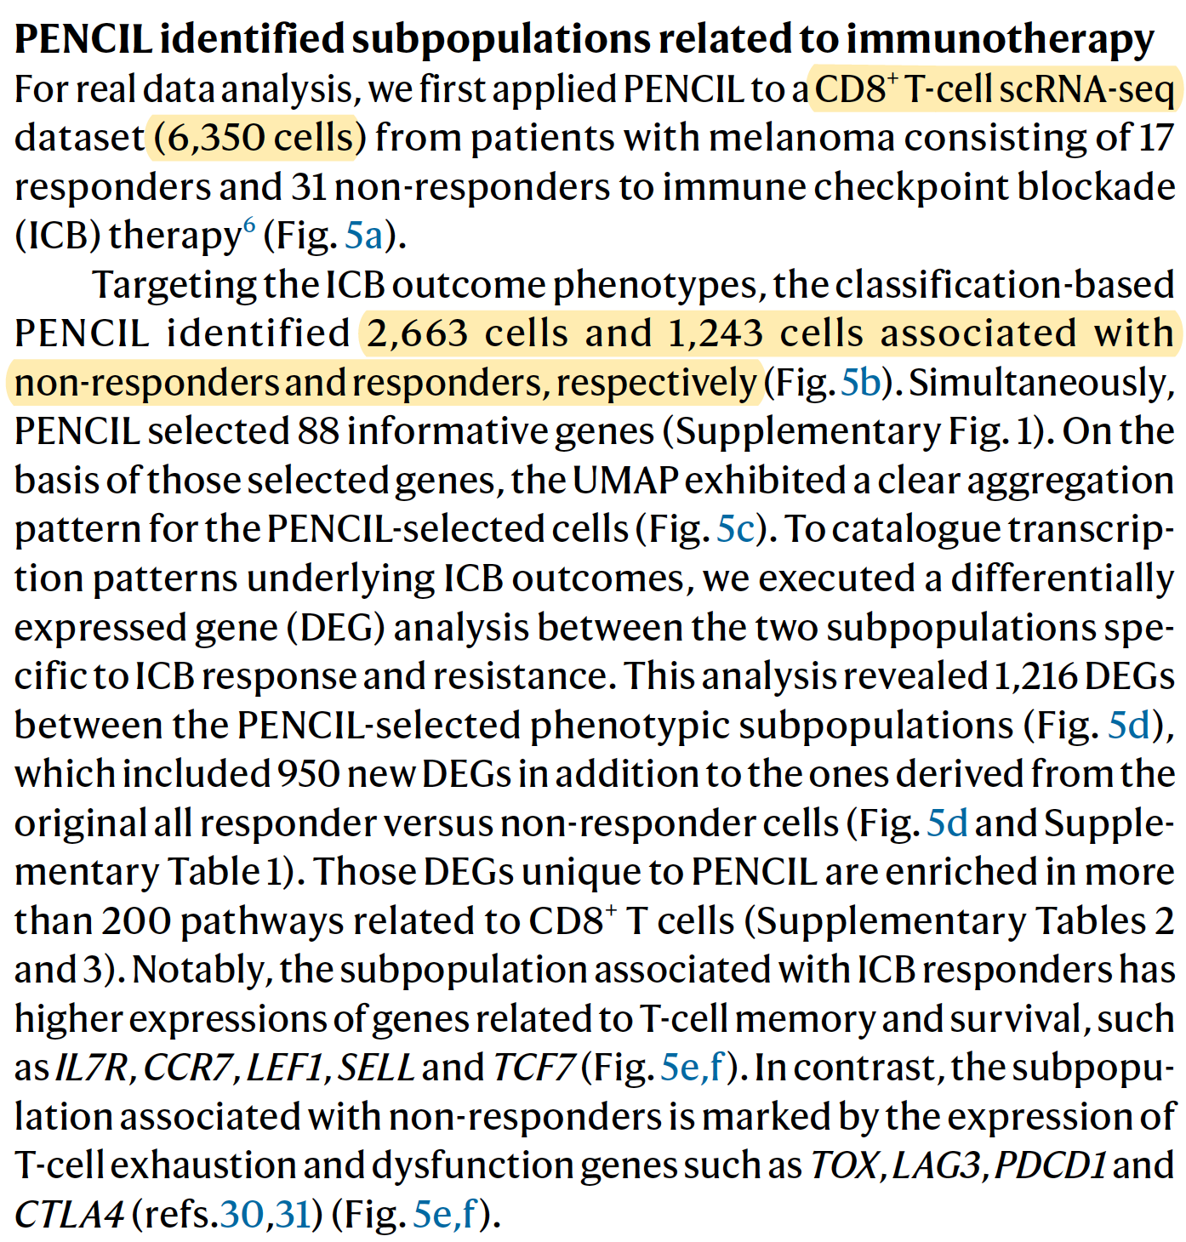
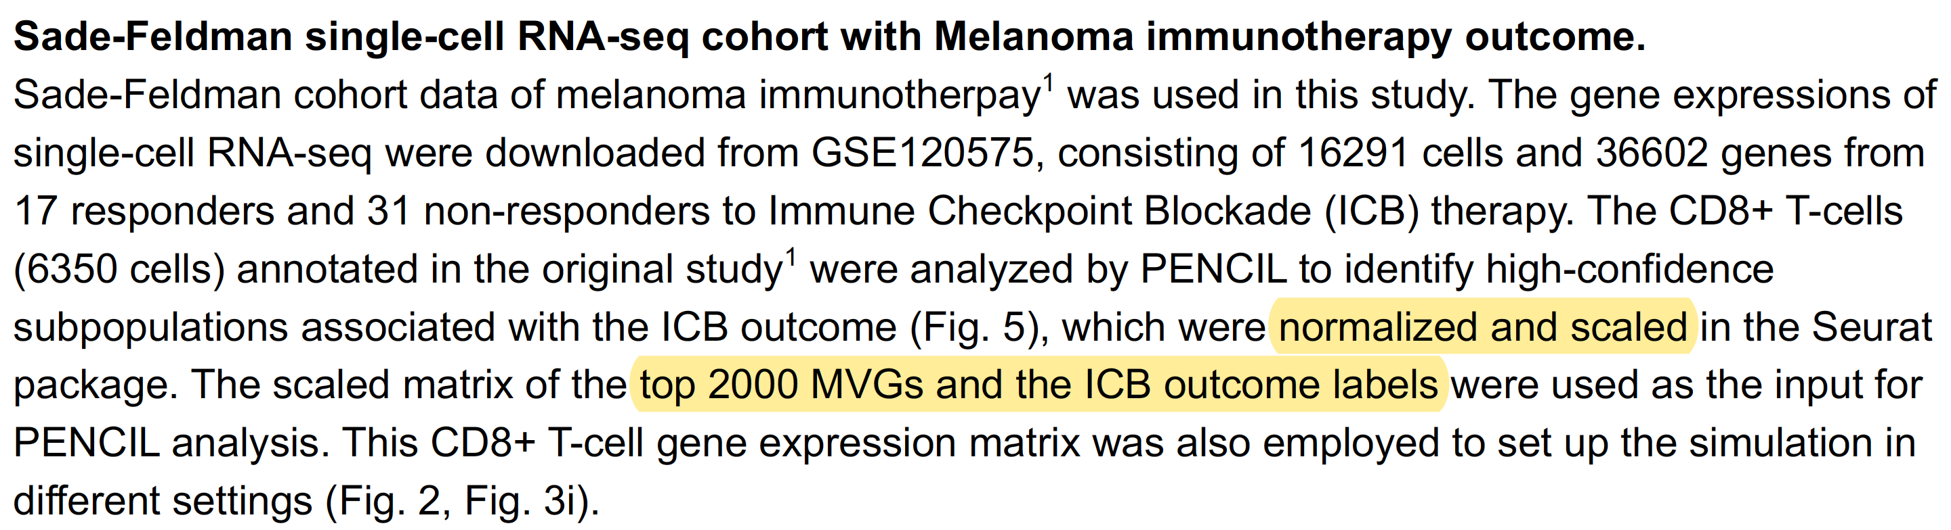
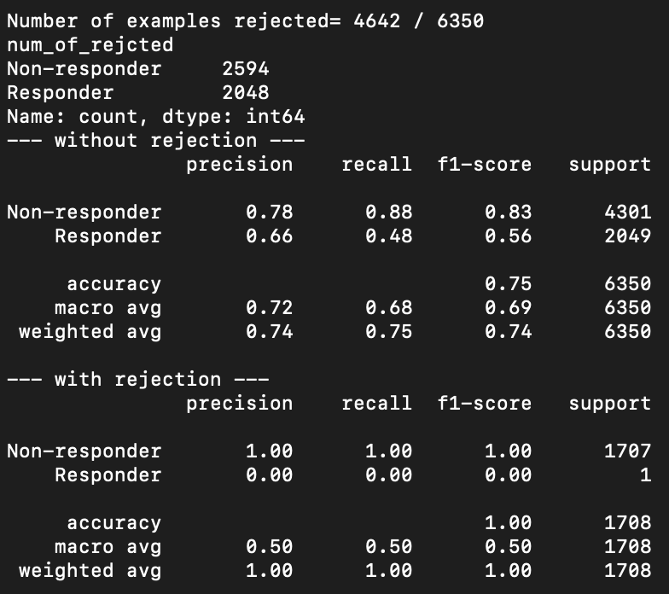
ISSUE: CANNOT reproduce PENCIL result with default parameters GSE120575
Solved: use .csv files; use class_weights = [2,1]
Other modification: scaled data on log2(TPM+1);
use the 20k+ protein coding genes provided in Sade-Feldman et al.;
use the scaling, PCA, clustering parameters by PENCIL authors.

Slide 3
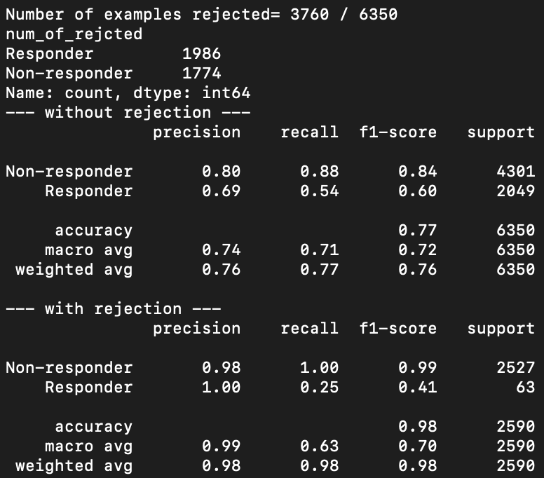
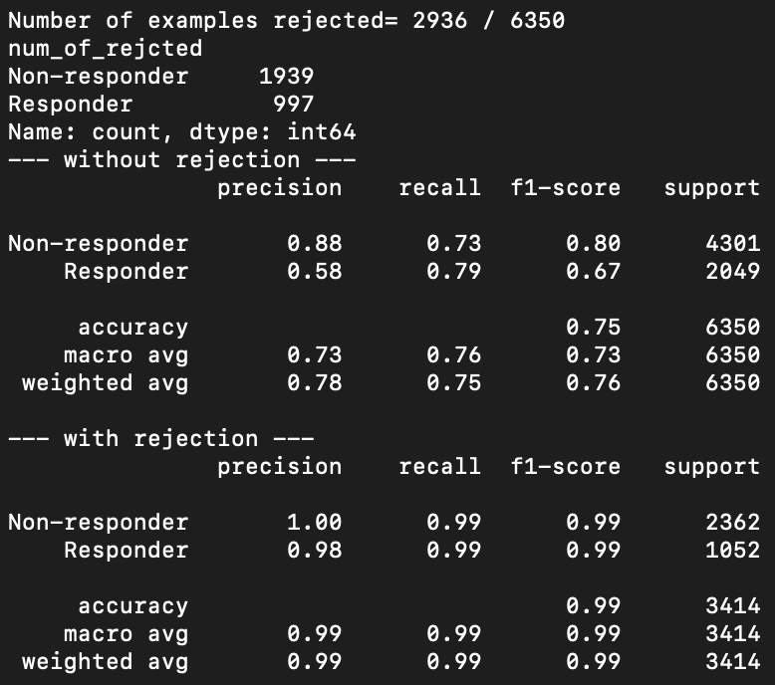
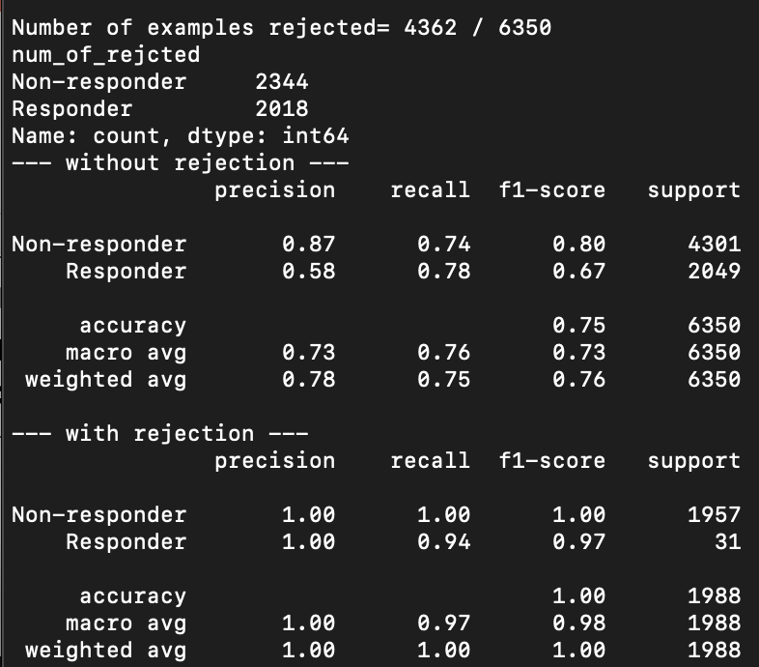
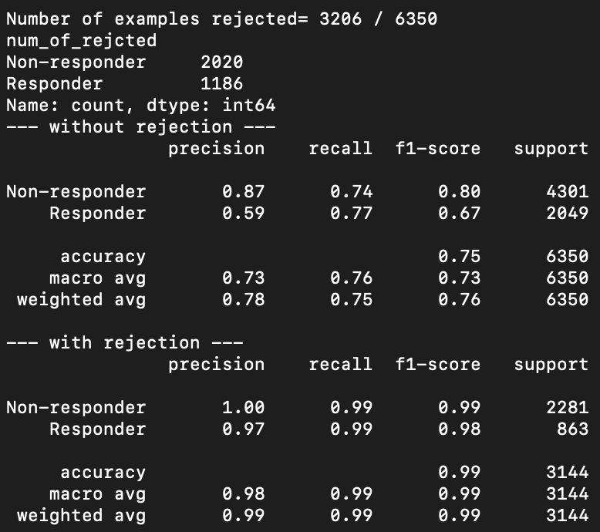
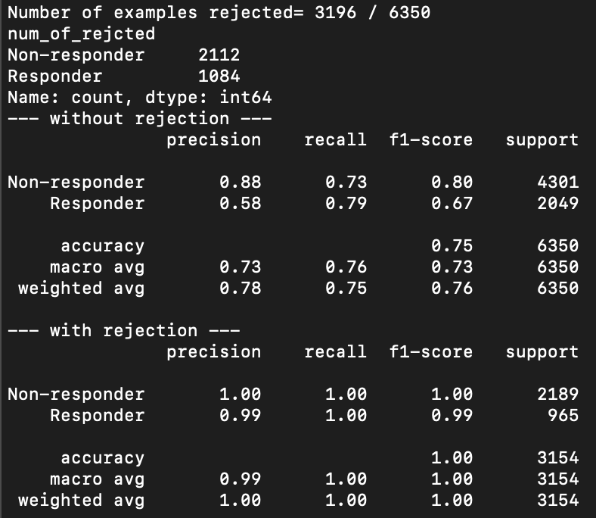

PENCIL issue 1: sensitive to class_weight setting. Class_weight is used to balance the cell number from NR and R patients. E.g., if 2000 and 1000 CD8T cells are from NR and R patients respectively, class_weight will need to be set to [1,2]. In PENCIL, default class_weight is None. Following results are from CD8T data in Sade-Feldman et al. 2018 Cell.
class_weight = None
class_weight = [2,1]
class_weight = [4301/2049, 1]
class_weight = [1.9, 1]
class_weight = [2.1, 1]
class_weight = [3, 1]

Slide 4

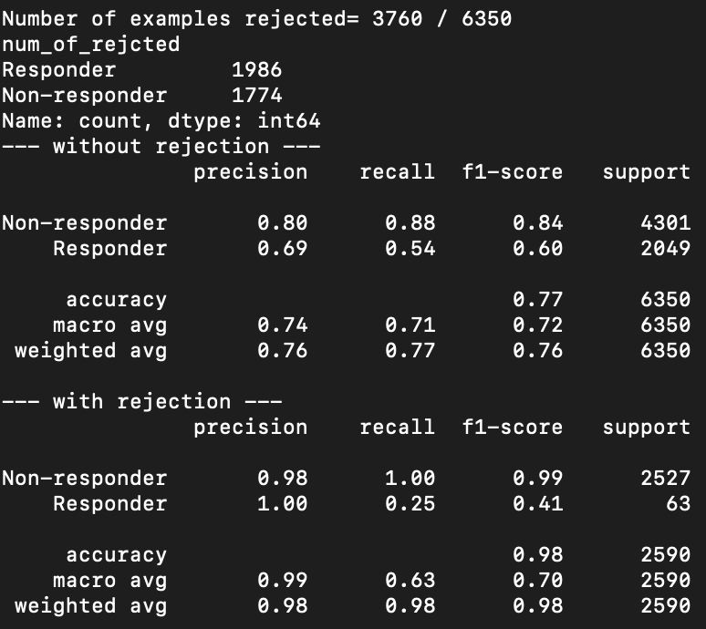
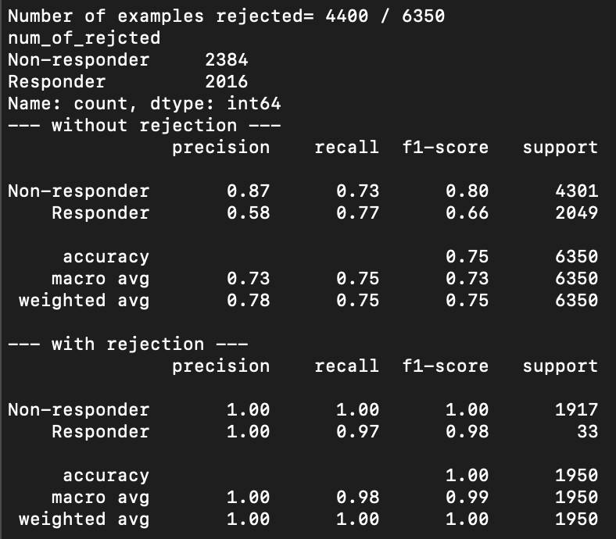
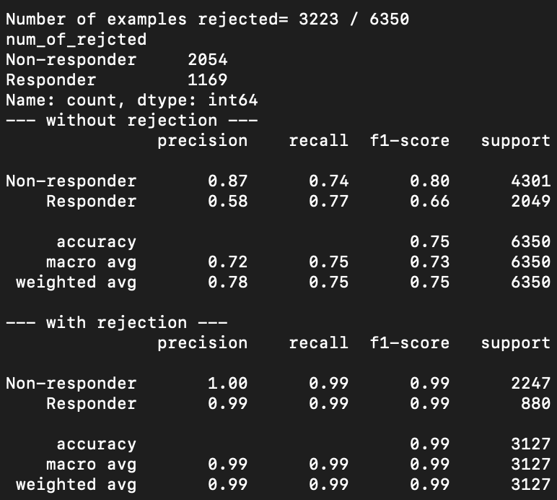
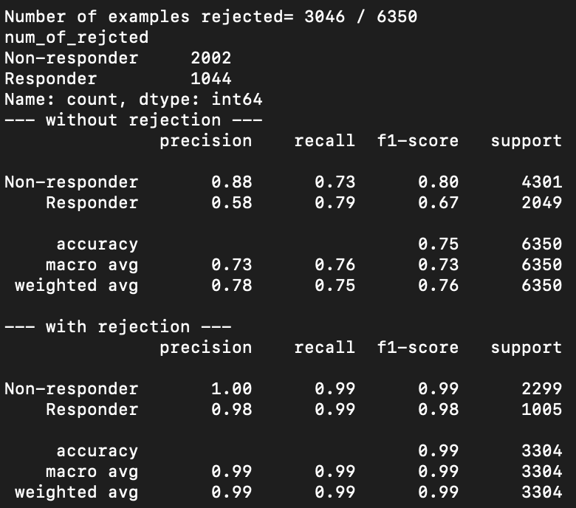
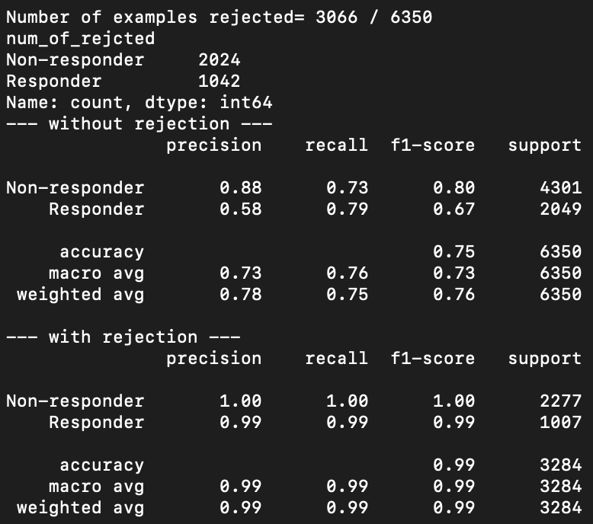
PENCIL issue 1: sensitive to class_weight setting. Class_weight is used to balance the cell number from NR and R patients. E.g., if 2000 and 1000 CD8T cells are from NR and R patients respectively, class_weight will need to be set to [1,2]. In PENCIL, default class_weight is None. Following results are from CD8T data in Sade-Feldman et al. 2018 Cell.
class_weight = [2.09, 1]
class_weight = [1,1]
class_weight = [2.099, 1]
class_weight = [1.901, 1]
class_weight = [2.001, 1]
class_weight = [1.999, 1]

Slide 5
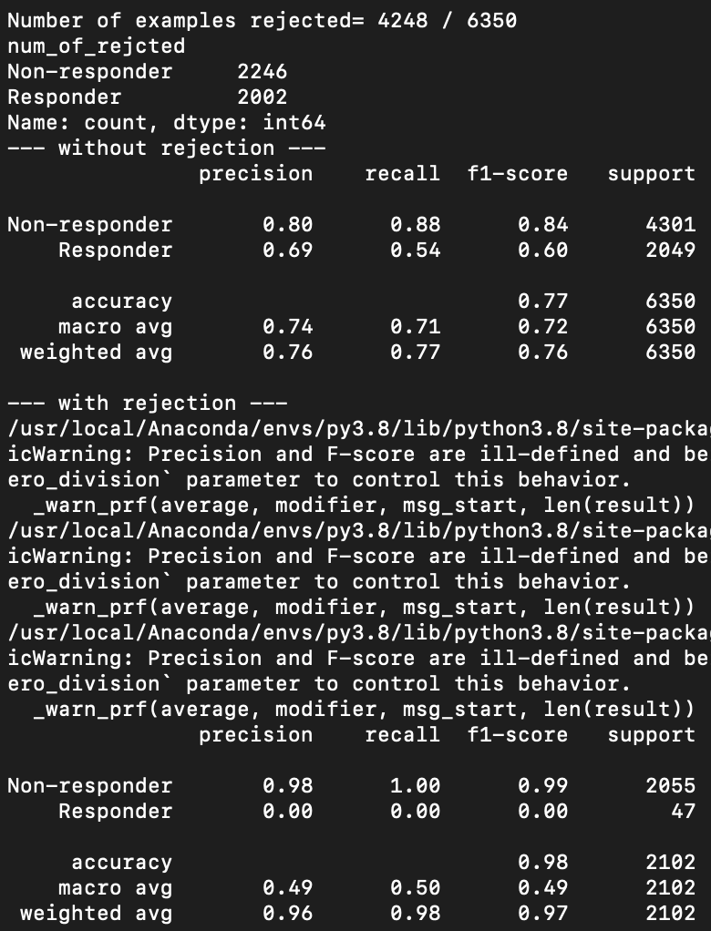
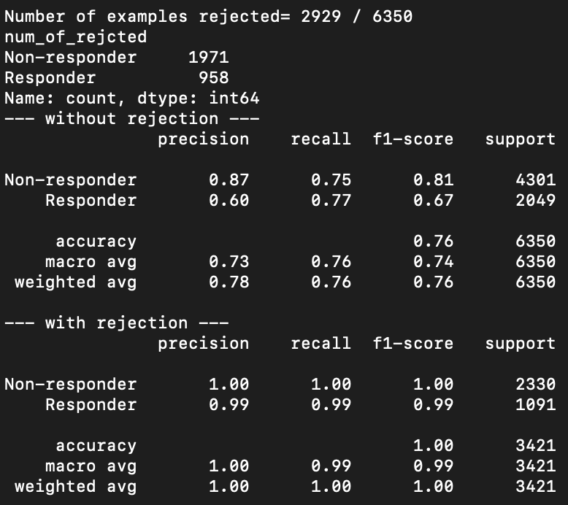


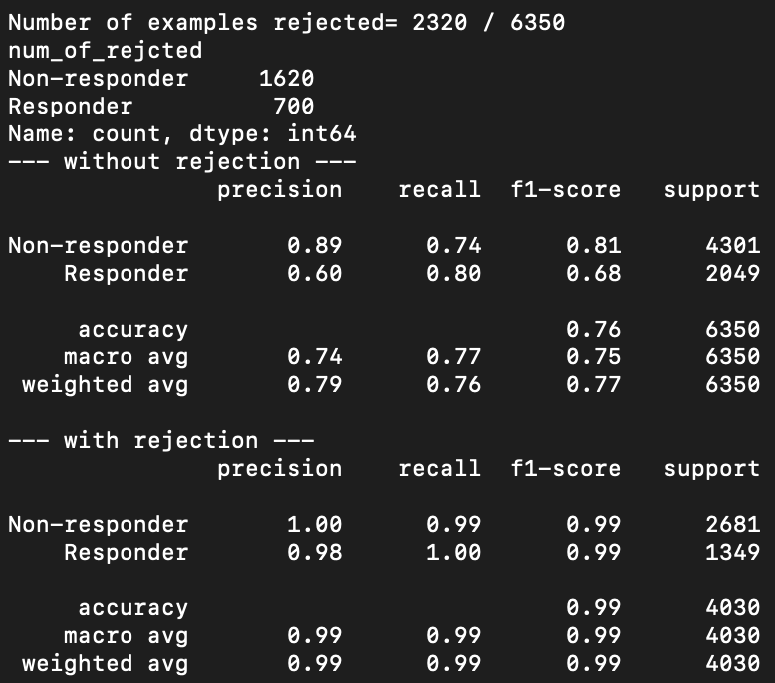
Report to PENCIL authors PENCIL issue 1: sensitive to class_weight setting. Class_weight is used to balance the cell number from NR and R patients. E.g., if 2000 and 1000 CD8T cells are from NR and R patients respectively, class_weight will be set to [1,2].
class_weight = None
class_weight = [2,1]
class_weight = [1.6, 1]
These results are from using .csv files as input.
class_weight = [2.1,1]
class_weight = [2.2,1]

Slide 6
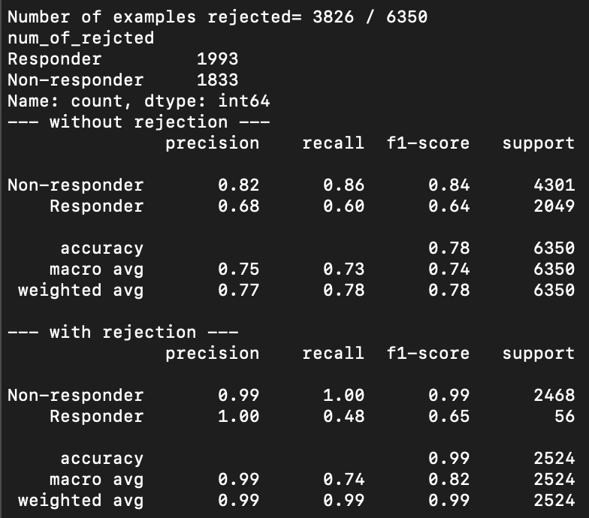
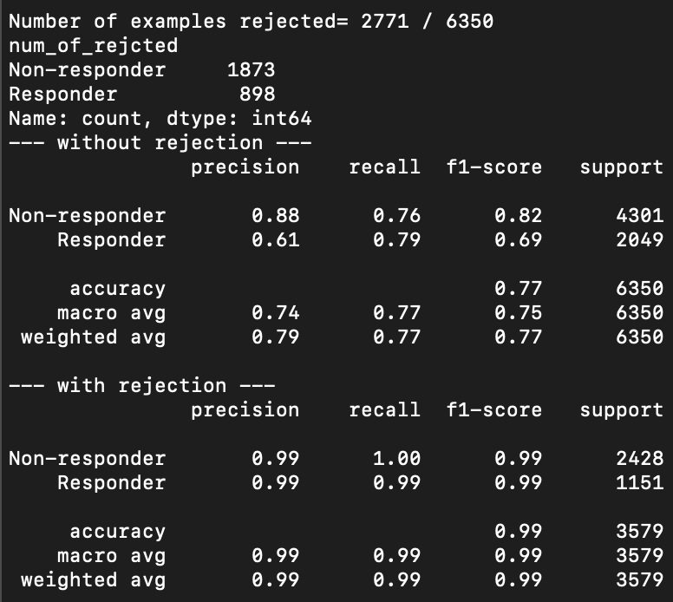
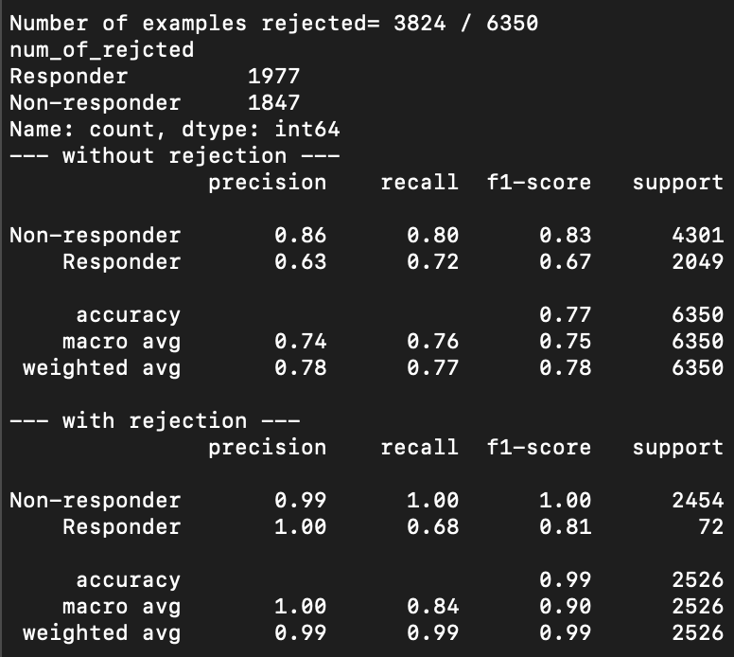
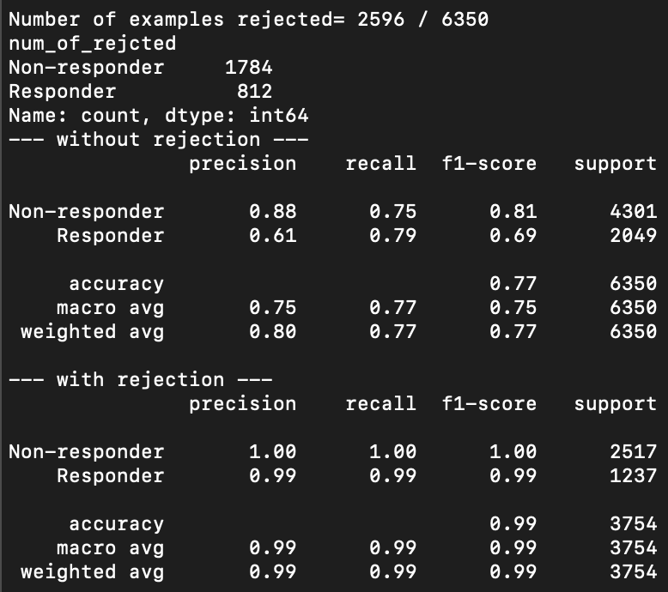
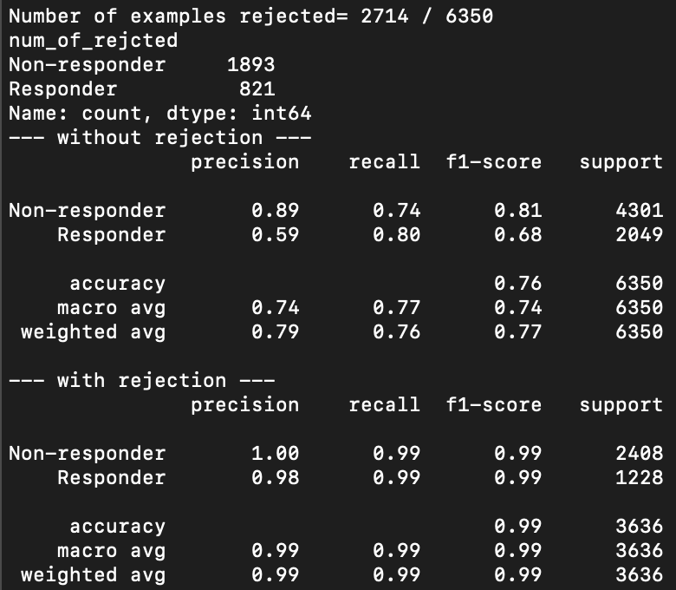
Report to PENCIL authors PENCIL issue 2: sensitive to input gene order. When using .csv or .h5ad files as input, the result differs. The only difference of .h5ad and .csv files is that the order of HVGs is different (in .h5ad, the genes are ordered by gene names).
class_weight = None
class_weight = [2,1]
class_weight = [1.6, 1]
These results are from using .h5ad file as input.
class_weight = [2.1,1]
class_weight = [2.2,1]

Slide 7
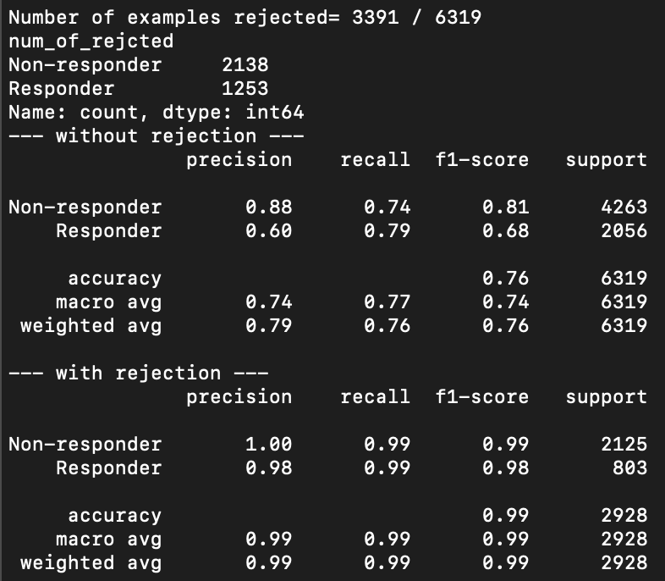
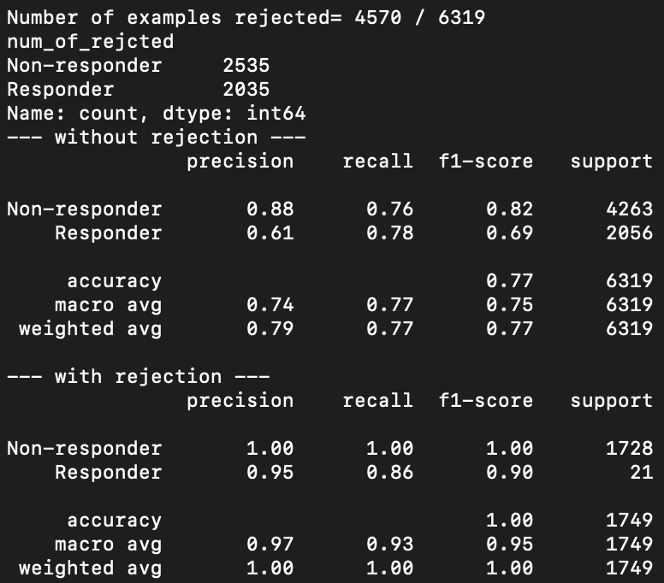
Report to PENCIL authors PENCIL issue 3: sensitive to input cells. When using custom annotated CD8T cells as input, although the overlap between custom annotated and Sade-Feldman et al. annotated is as high as 92%, the result differs very much.
CD8T cells annotated by Sade-Feldman et al. (cell number: 6350) .csv
CD8T cells annotated by Sade-Feldman et al. (cell number: 6350) .h5ad
(Common cell number: 5840)
CD8T cells annotated by myself
(cell number: 6319) .csv
CD8T cells annotated by myself
(cell number: 6319) .h5ad

Slide 8
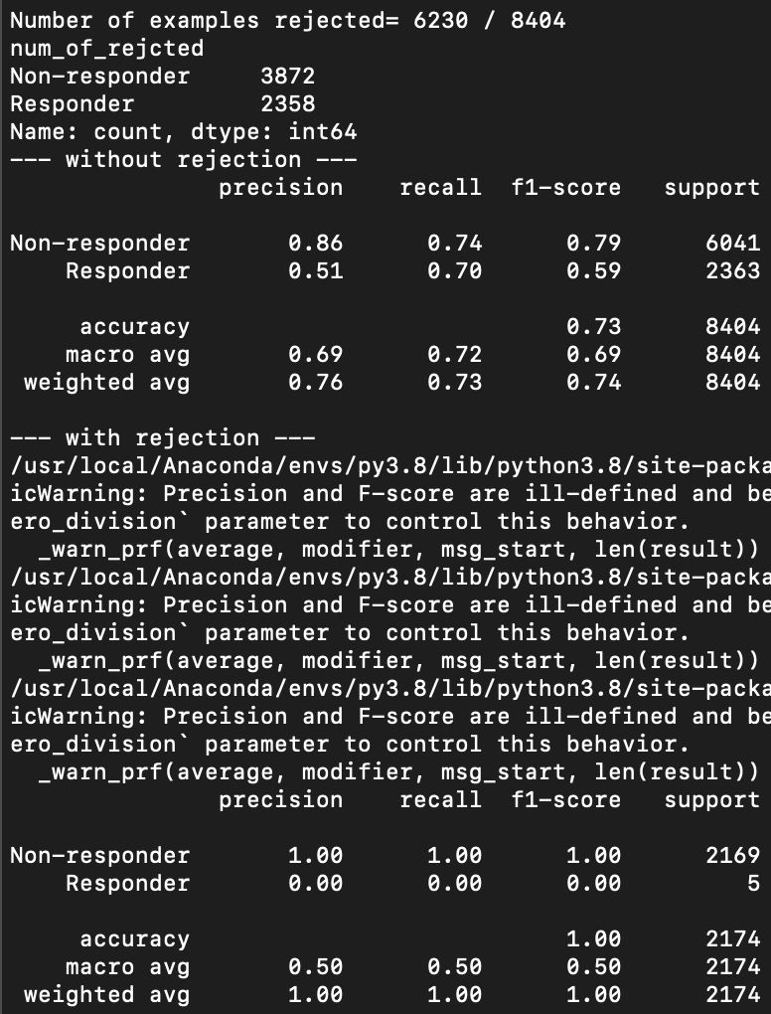
Report to PENCIL authors PENCIL issue 3: sensitive to input cells. When using celltypist annotated CD8T cells as input, PENCIL cannot predict Responder related cells.
CD8T cells annotated by celltypist
(cell number: 8404) .csv

Slide 9
To do list
Get response from the PENCIL authors about the reproducibility on the melanoma data GSE120575
Get at least one scRNAseq dataset with ICB response information for HNSCC or TNBC or melanoma
Functional analysis of phenotype-related cells identified by PENCIL to get biological insights from the results

Slide 10
Pipeline
Step 0: Raw data preprocessing, QC, normalization, cell annotation (use original annotation if provided with paper, e.g. GSE120575 CD8T)
Step 1: Add phenotype info. to Seurat object
Step 2: Subset to cell types of interest (e.g., CD4T, CD8T, B cells), and save to .h5ad
Step 3: Run PENCIL
Step 4: Downstream analysis of phenotype-related cells

Slide 11
Planned results for the manuscript
1. Ratio between phenotype-related cells (yes/no) may be used to predict phenotype of a patient (e.g. ICB response)
2. Marker gene analysis of phenotype-related cells
3. functional (GO/pathway) analysis of genes/cells
4. Optional: Compare with intuitive methods such as counting the cells from R/NR in each cluster and identify phenotype-related clusters and the marker genes

Slide 12
Idea
Predicting phenotype using phenotype-related cells
1. Regarding GSE120575, there are 44 samples. Using 30 to train the model, 14 to evaluate the predictive power. Stratifying R/NR during train/test splitting.
2.
s

Slide 14
Logic and result of GSE200996 analysis
Predicting phenotype using phenotype-related cells
Logic
1. Using tissue CD8T, CD4T, B cells respectively
2. Using PBMC CD8T, CD4T, B cells respectively
Result
Tissue immune cells better correlate with ICB response (measured by >10% tumor reduction), where B cells have the best correlation. PBMC CD4T and B cells barely have correlation with ICB response. Interestingly, PBMC CD8T cells still have strong correlation with ICB response. See more details on the next slide.

Slide 15
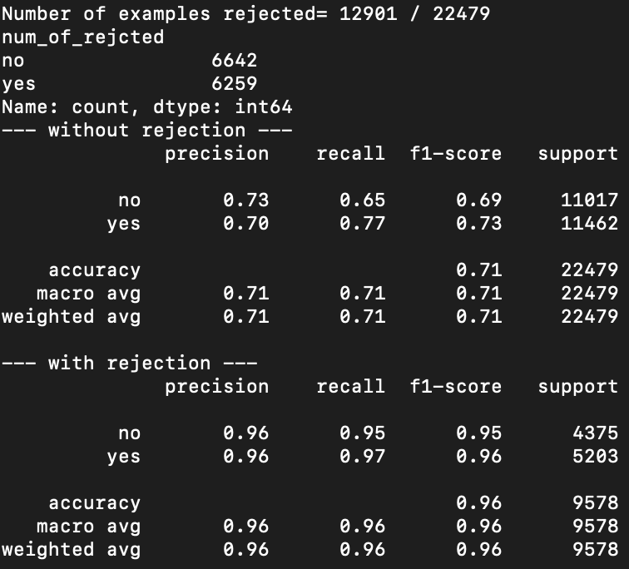
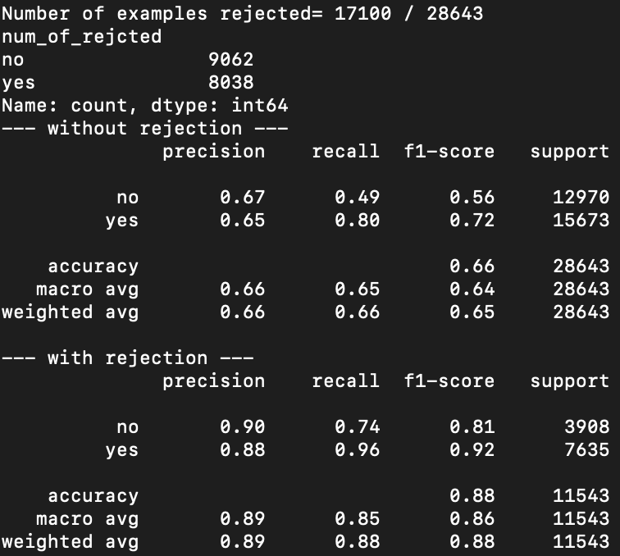
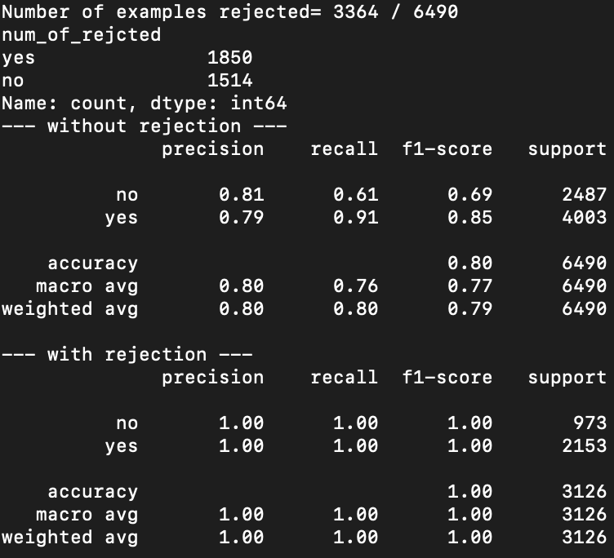
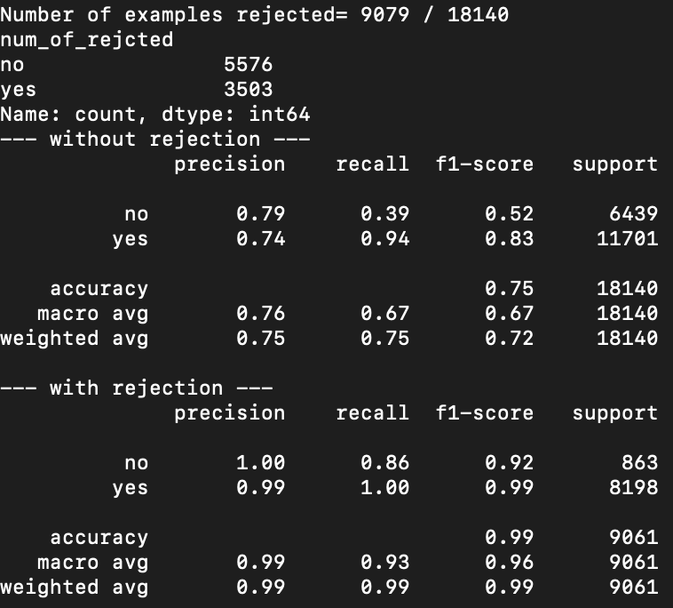

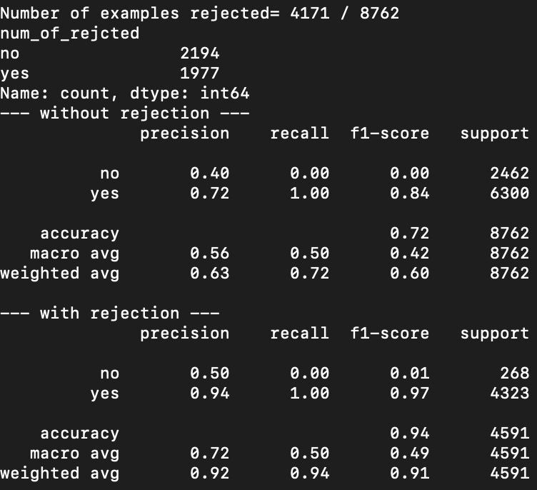
GSE200996: PENCIL result (Incorrect: did not re-do normalization, scaling and PCA for the subset of data)
Tissue CD8T
Tissue CD4T
Tissue B cells
PBMC CD8T
PBMC CD4T
PBMC B cells

Slide 16

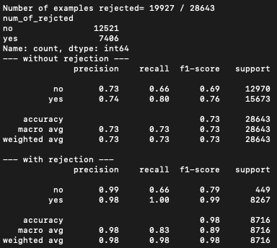
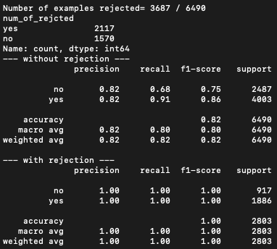



GSE200996: PENCIL result (corrected result)
Tissue CD8T
Tissue CD4T
Tissue B cells
PBMC CD8T
PBMC CD4T
PBMC B cells

Slide 17
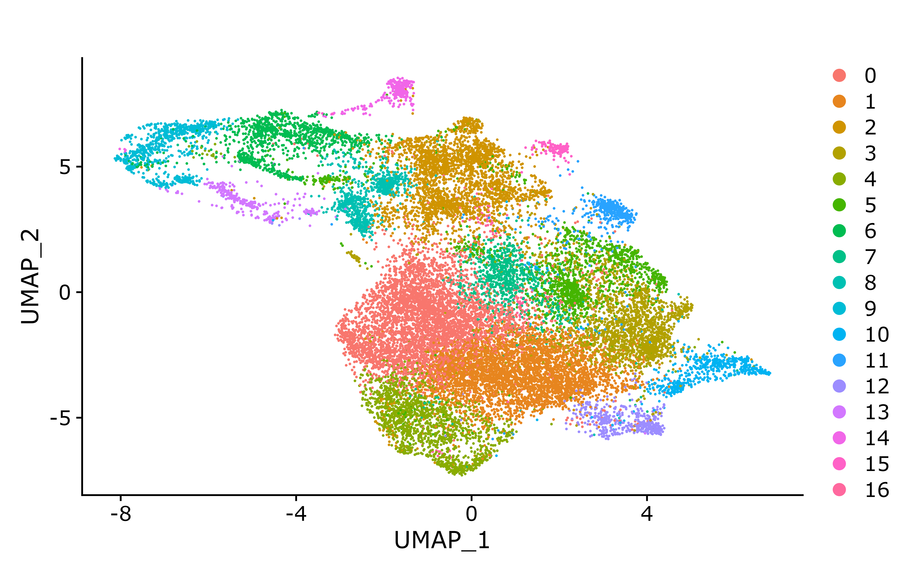
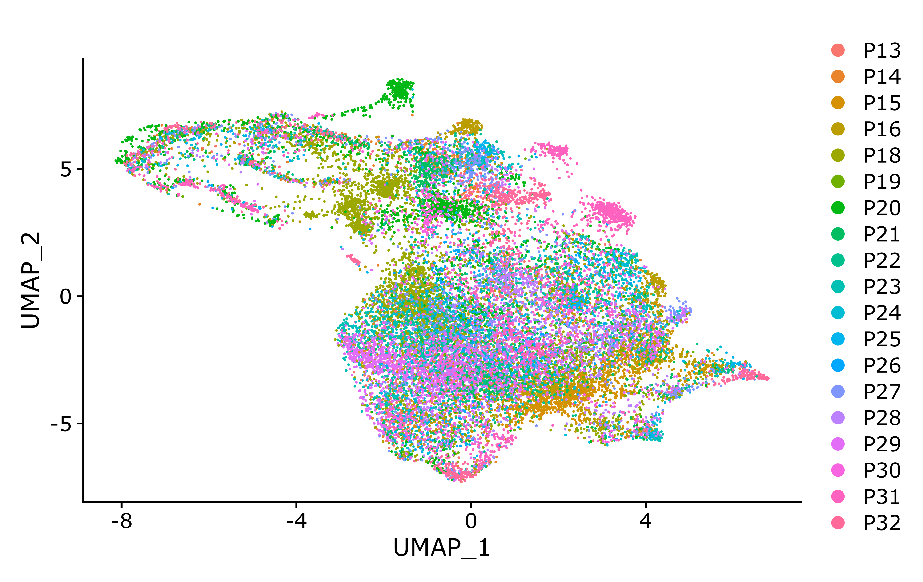
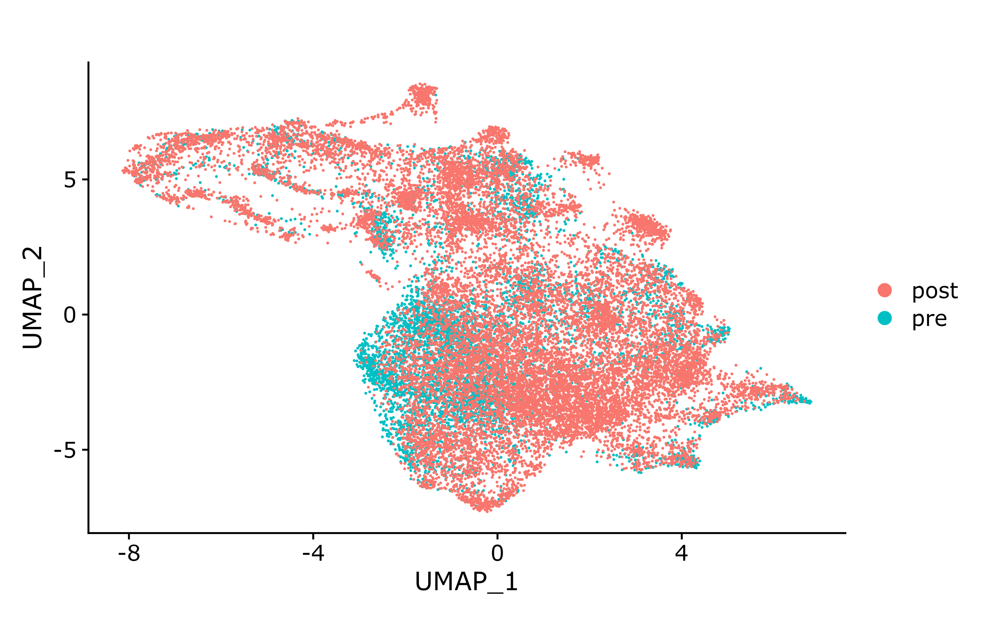
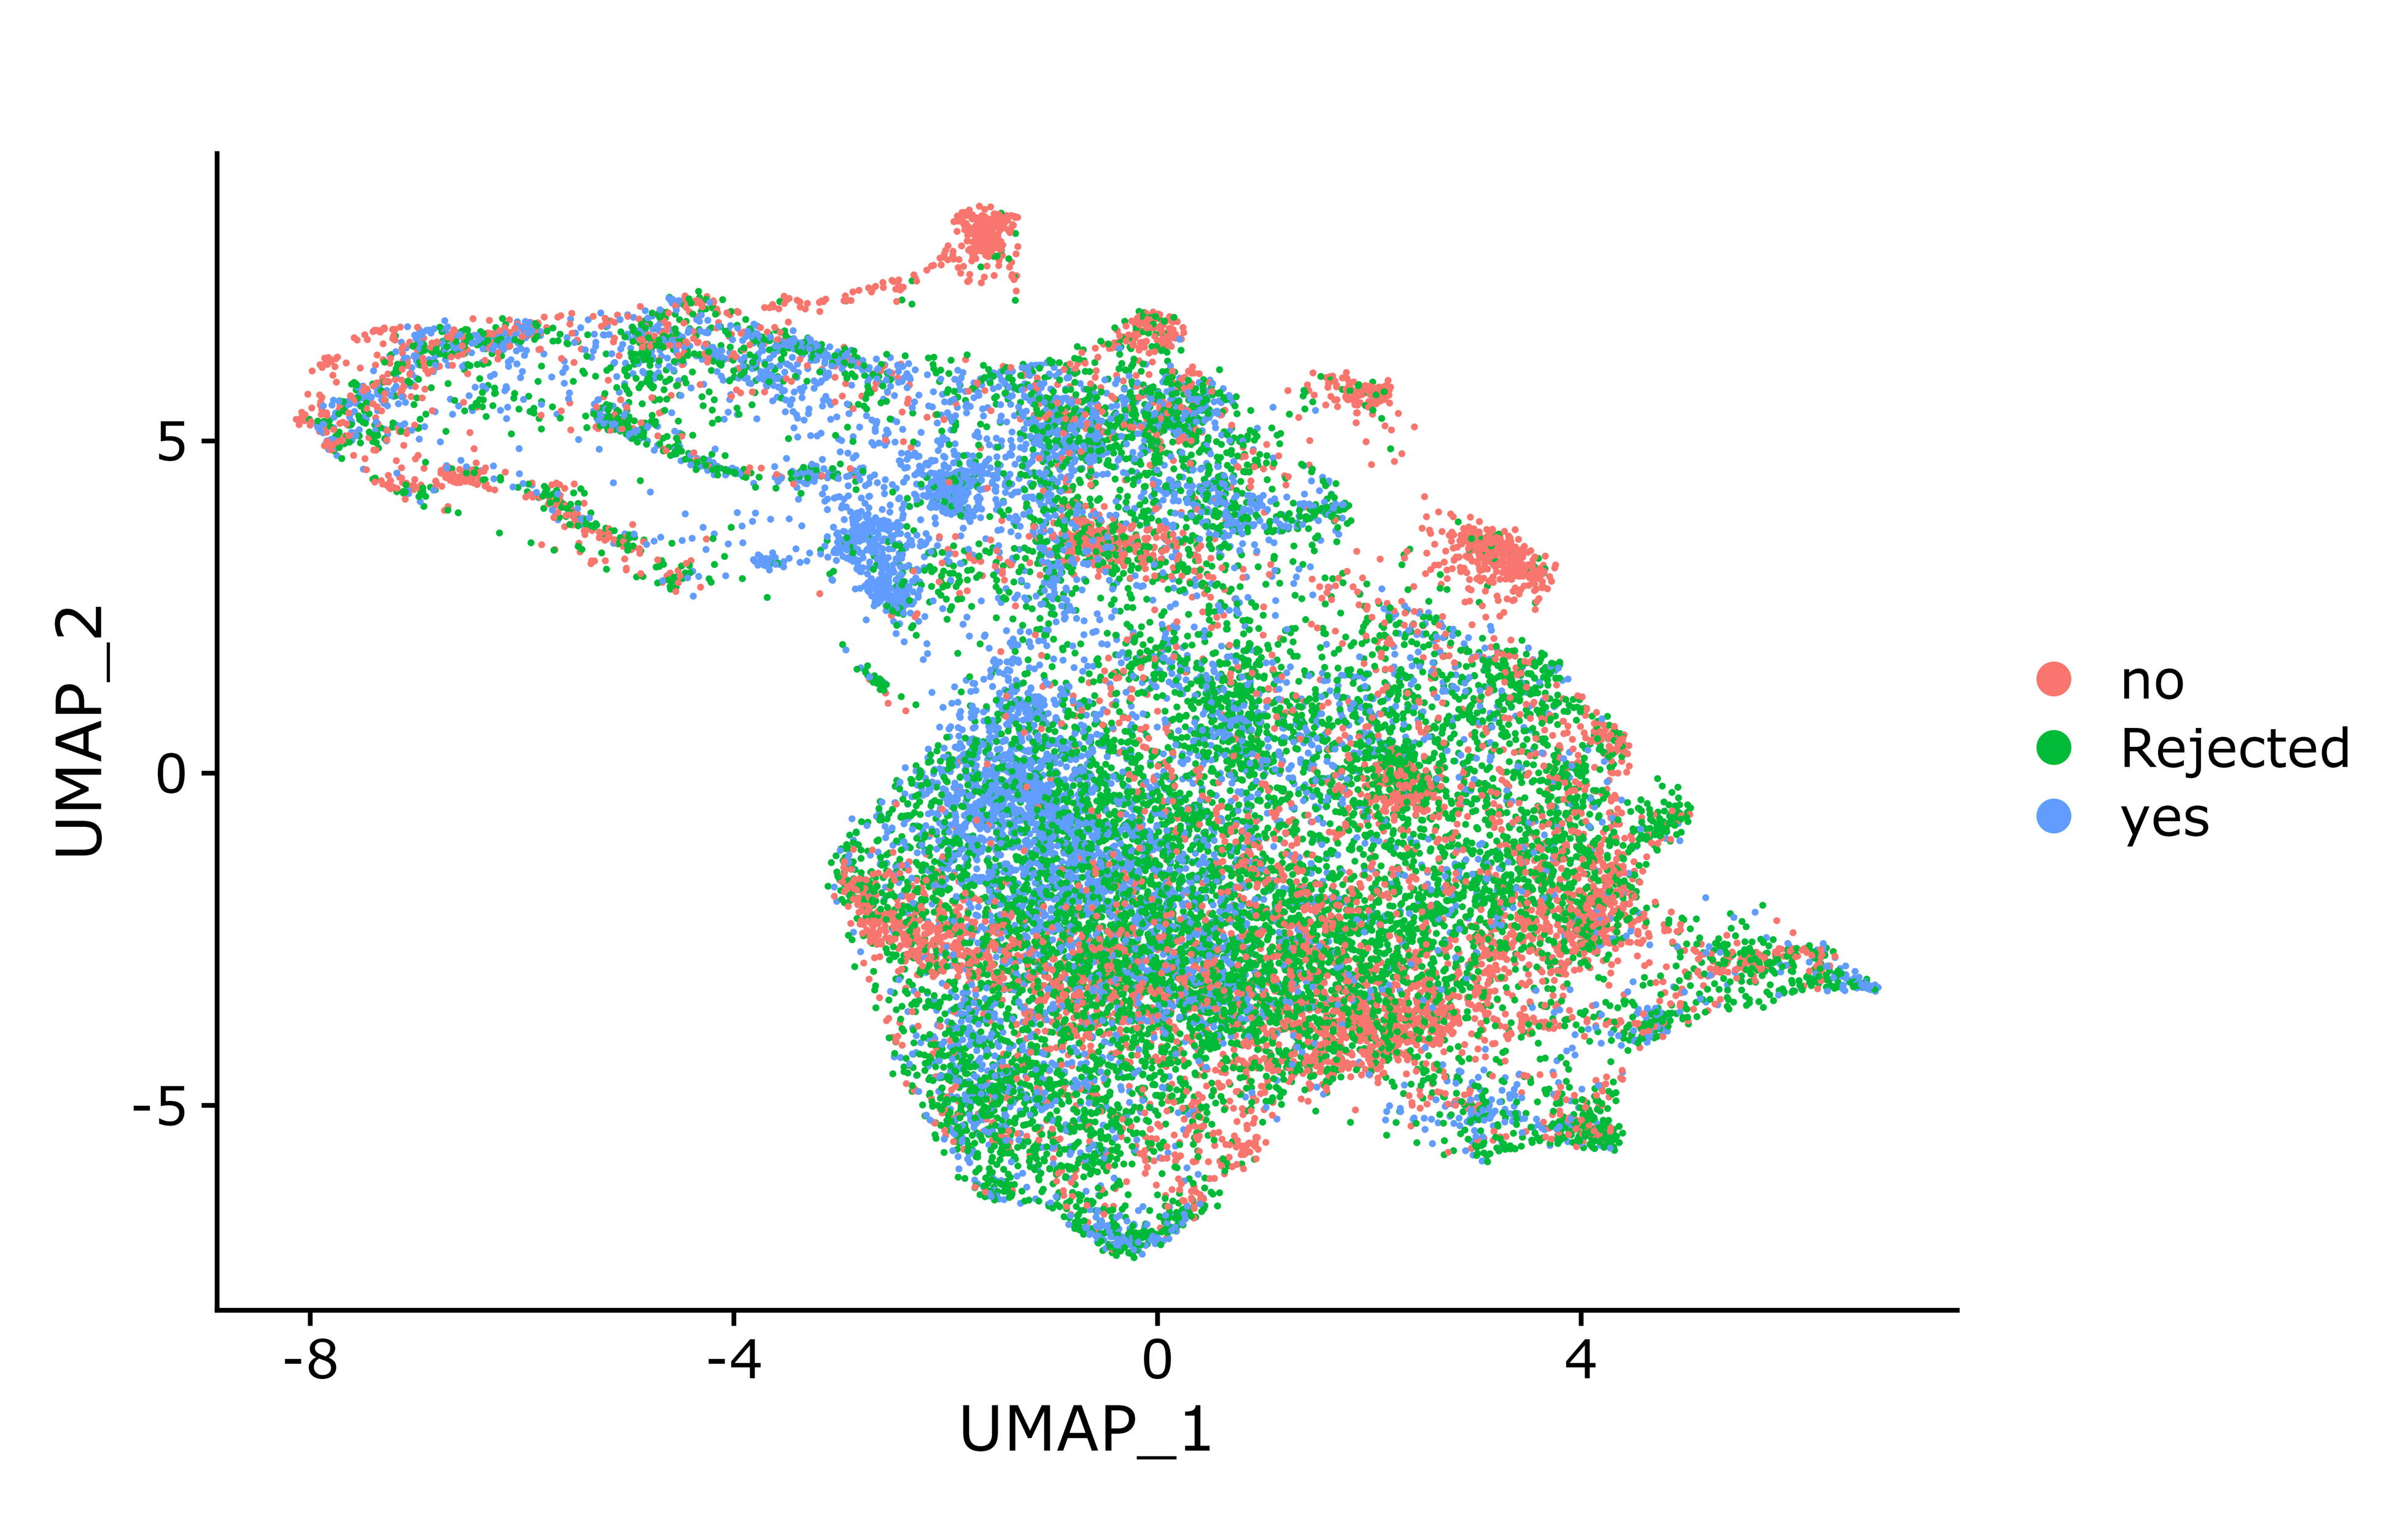
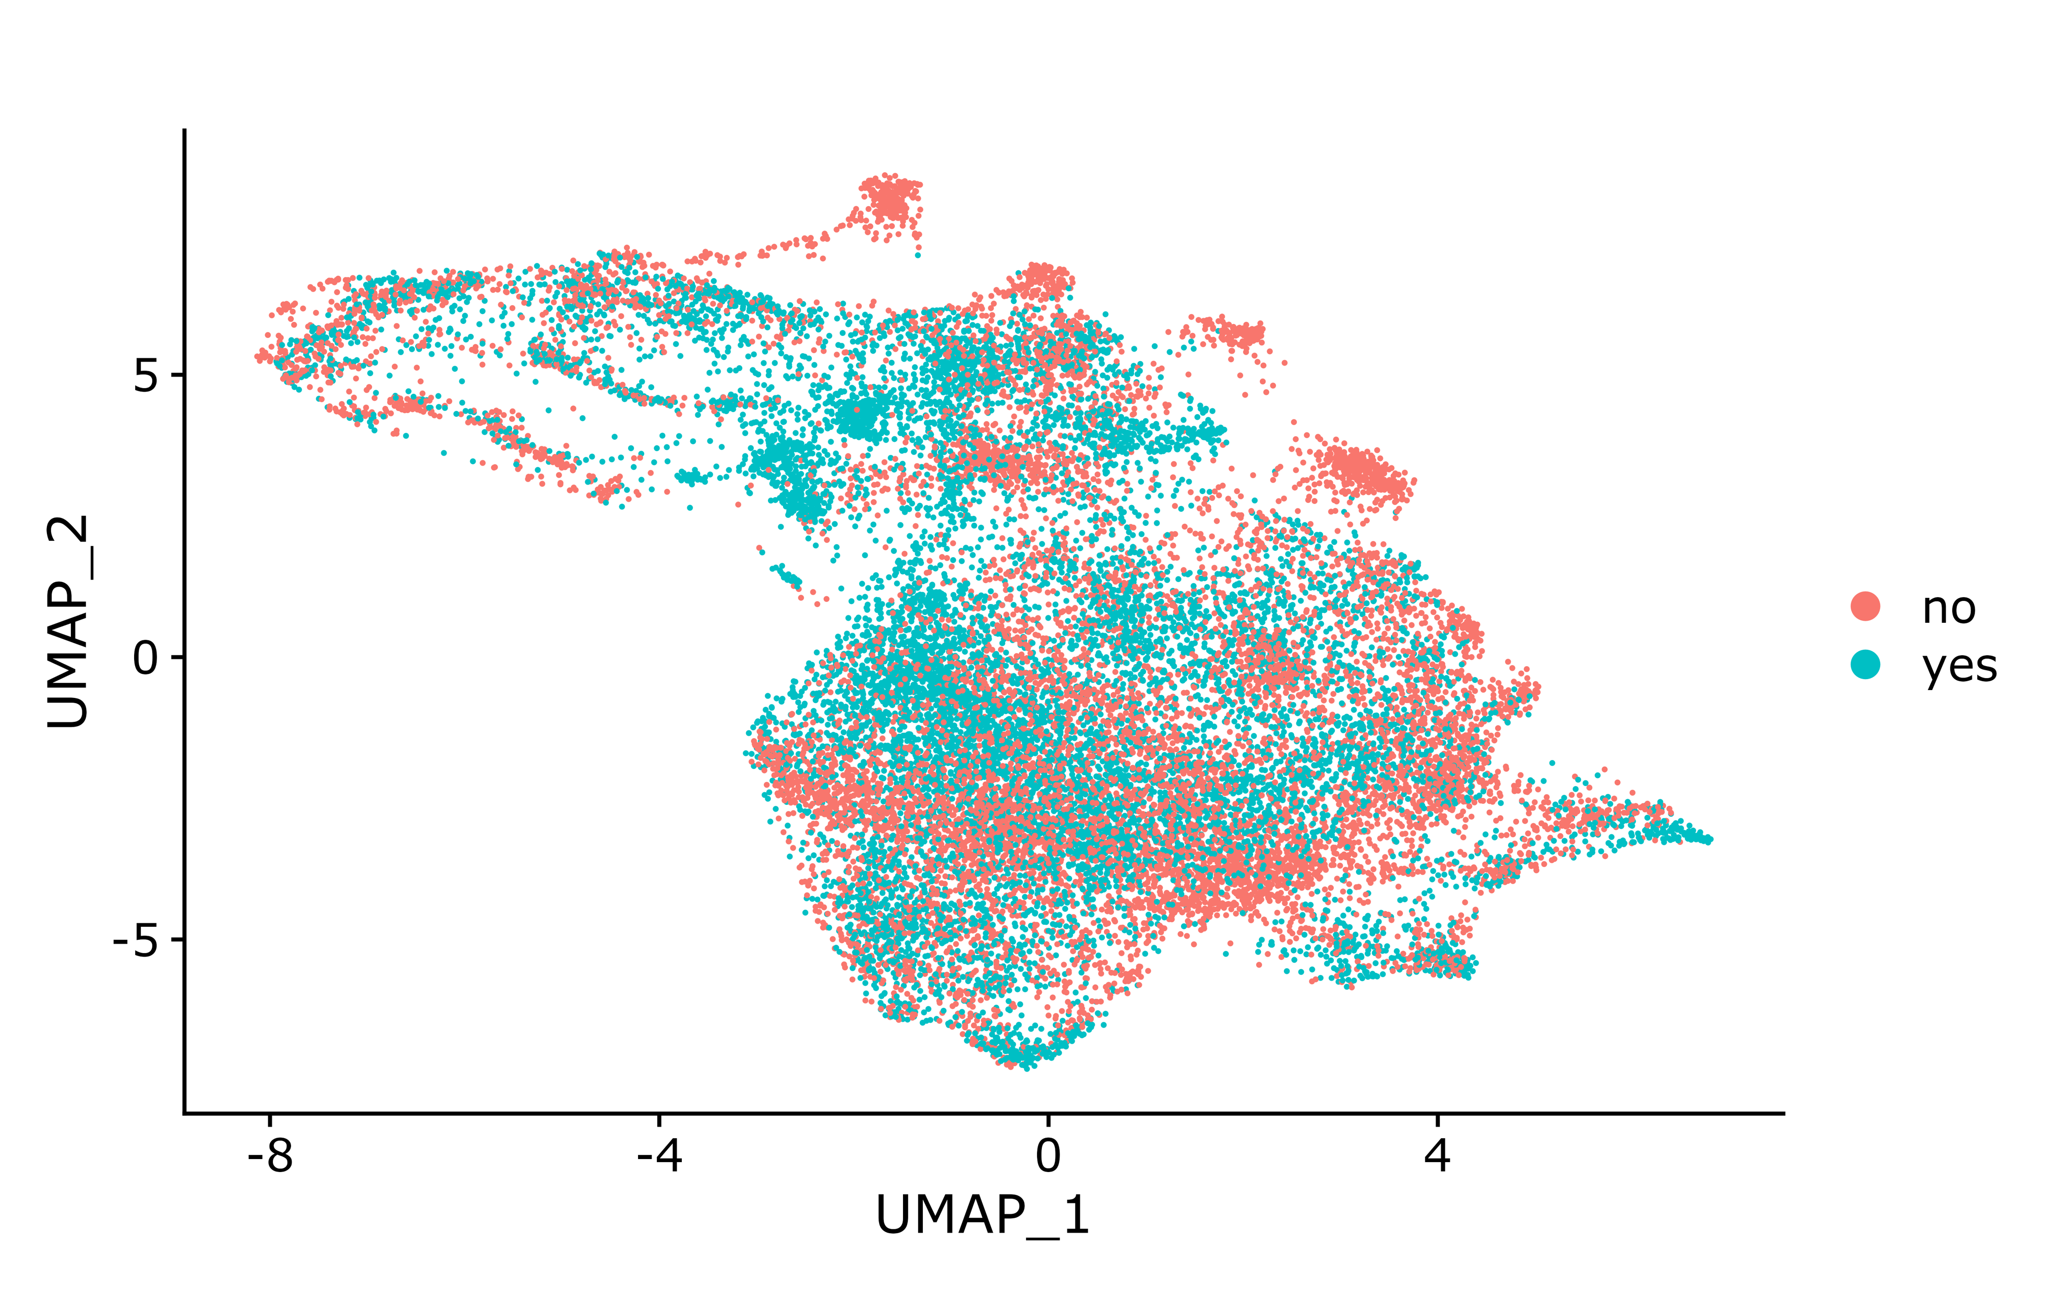
GSE200996: PENCIL result (corrected result for tissue CD8T cells)
Seurat clusters (for reference)
Patients (check batch effect)
Time point (Pre/Post ICB)
PENCIL predicted cell labels
R/NR patients (check R/NR specific clusters)

Slide 18
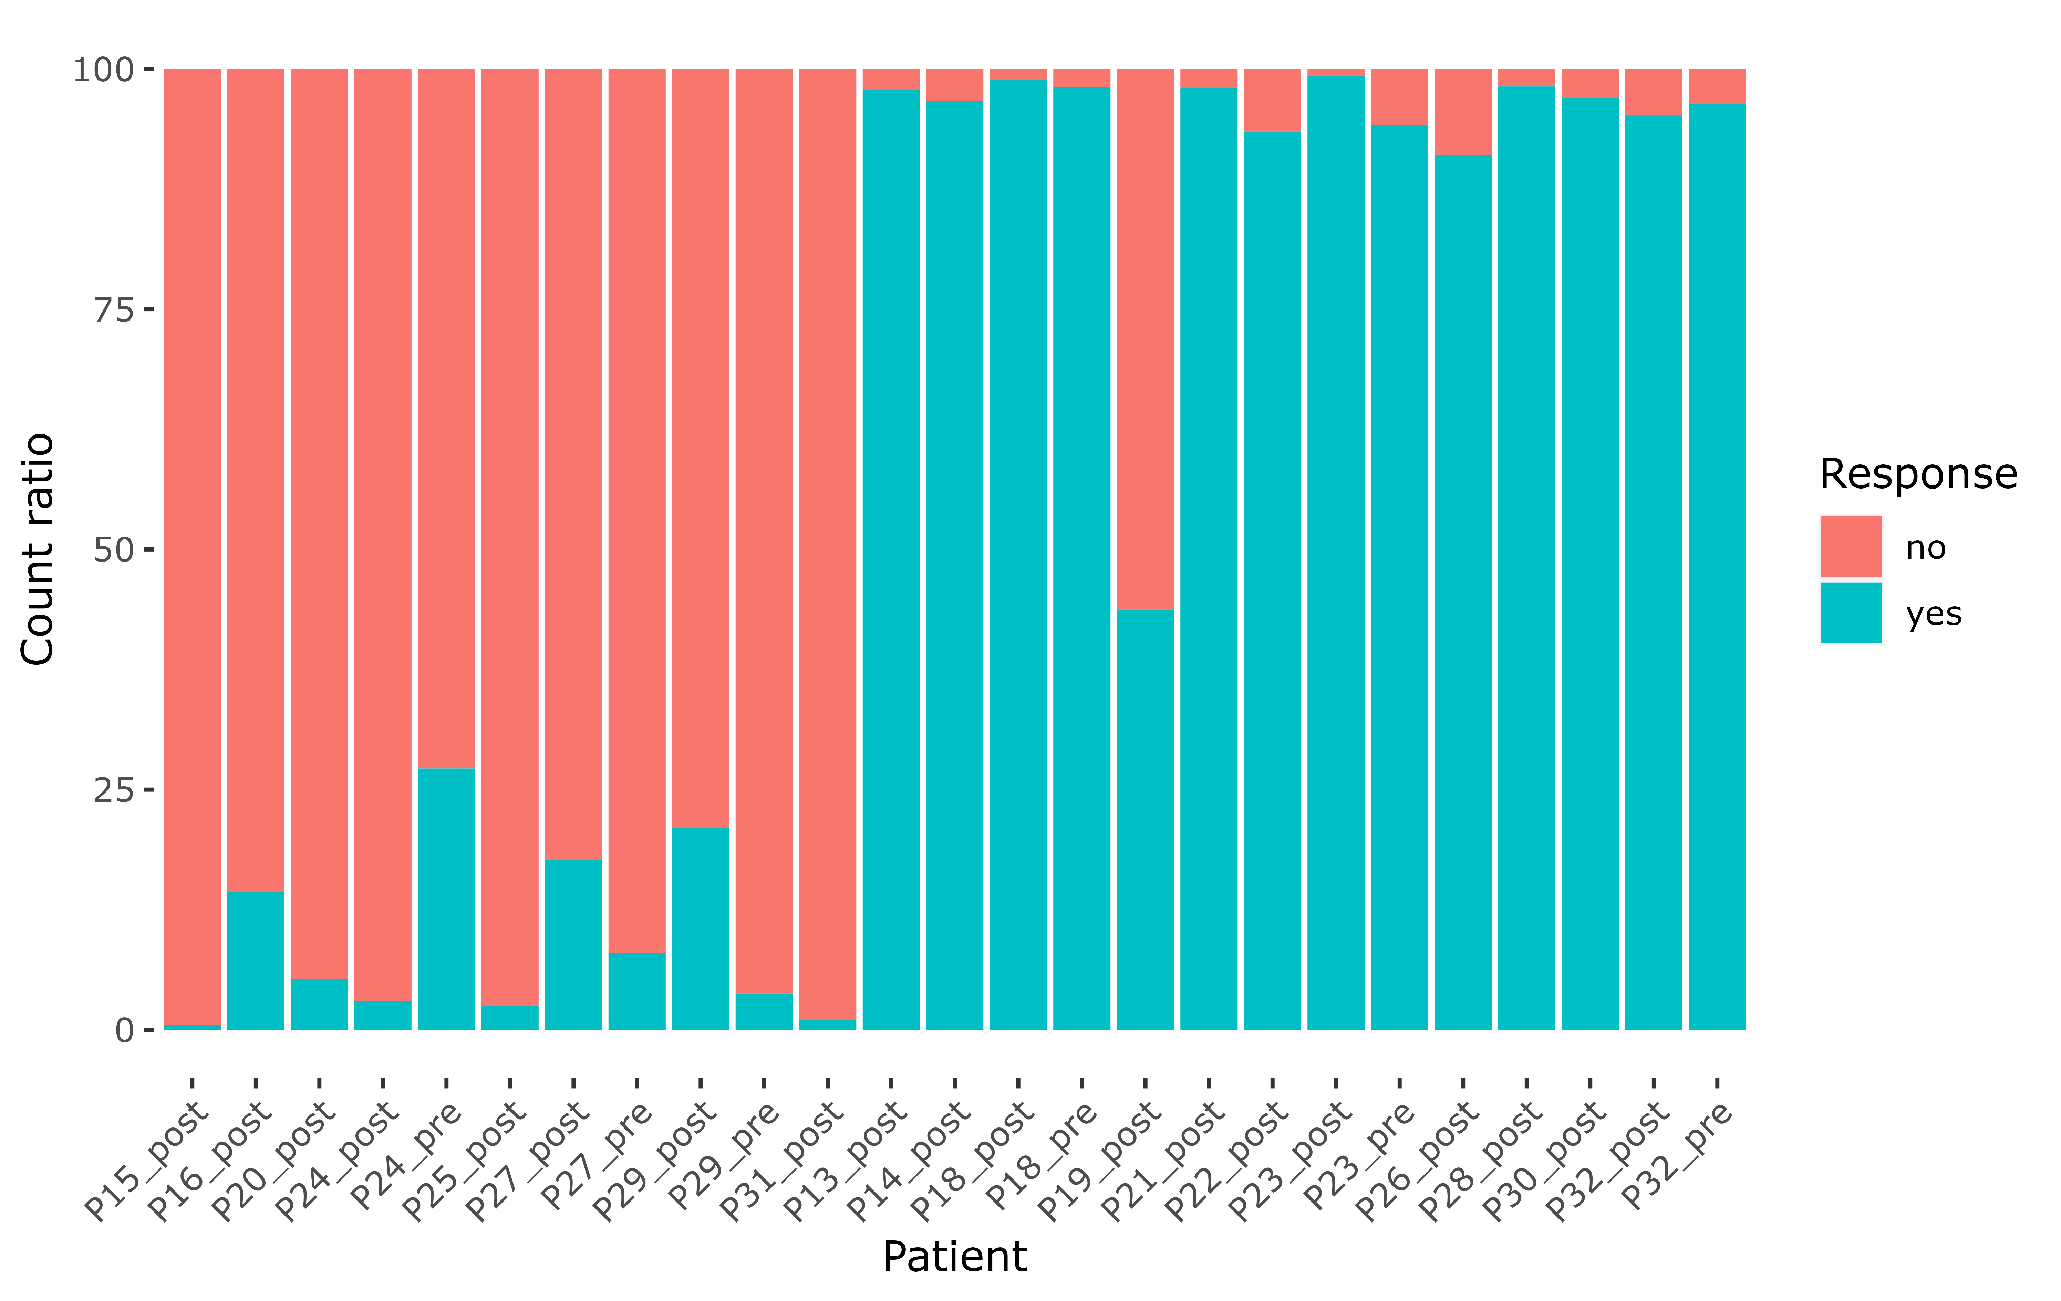
GSE200996: distribution of phenotype-related cells in each patient (for tissue CD8T cells, this is ALL training data)
Non-responders
Responders

Slide 19
GSE200996: known ICB signature score for PENCIL annotated phenotype-related cells (corrected result for tissue CD8T cells)

Slide 20
GSE200996: ICG (immune checkpoint genes) expression for PENCIL annotated phenotype-related cells (corrected result for tissue CD8T cells)

Slide 21
GSE200996: ICG (immune checkpoint genes) expression for PENCIL annotated phenotype-related cells (corrected result for tissue CD8T cells)

Slide 22
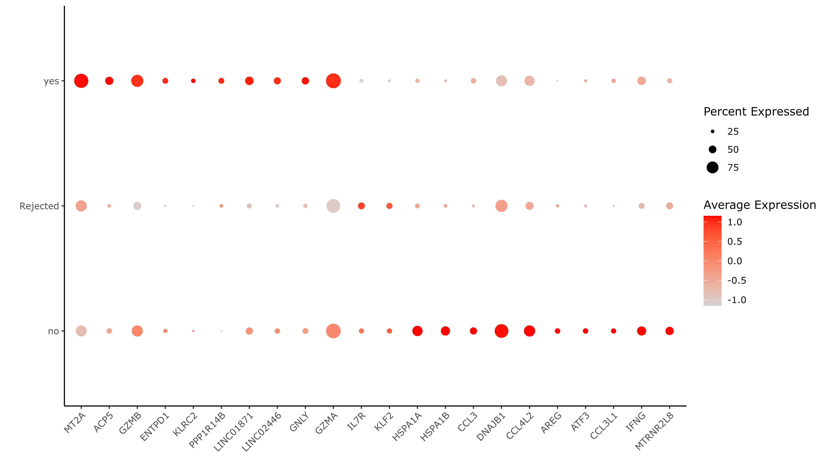
GSE200996: Marker genes for PENCIL annotated phenotype-related cells (corrected result for tissue CD8T cells)
Responder cell markers
Rejected cell markers
Non-responder cell markers

Slide 23
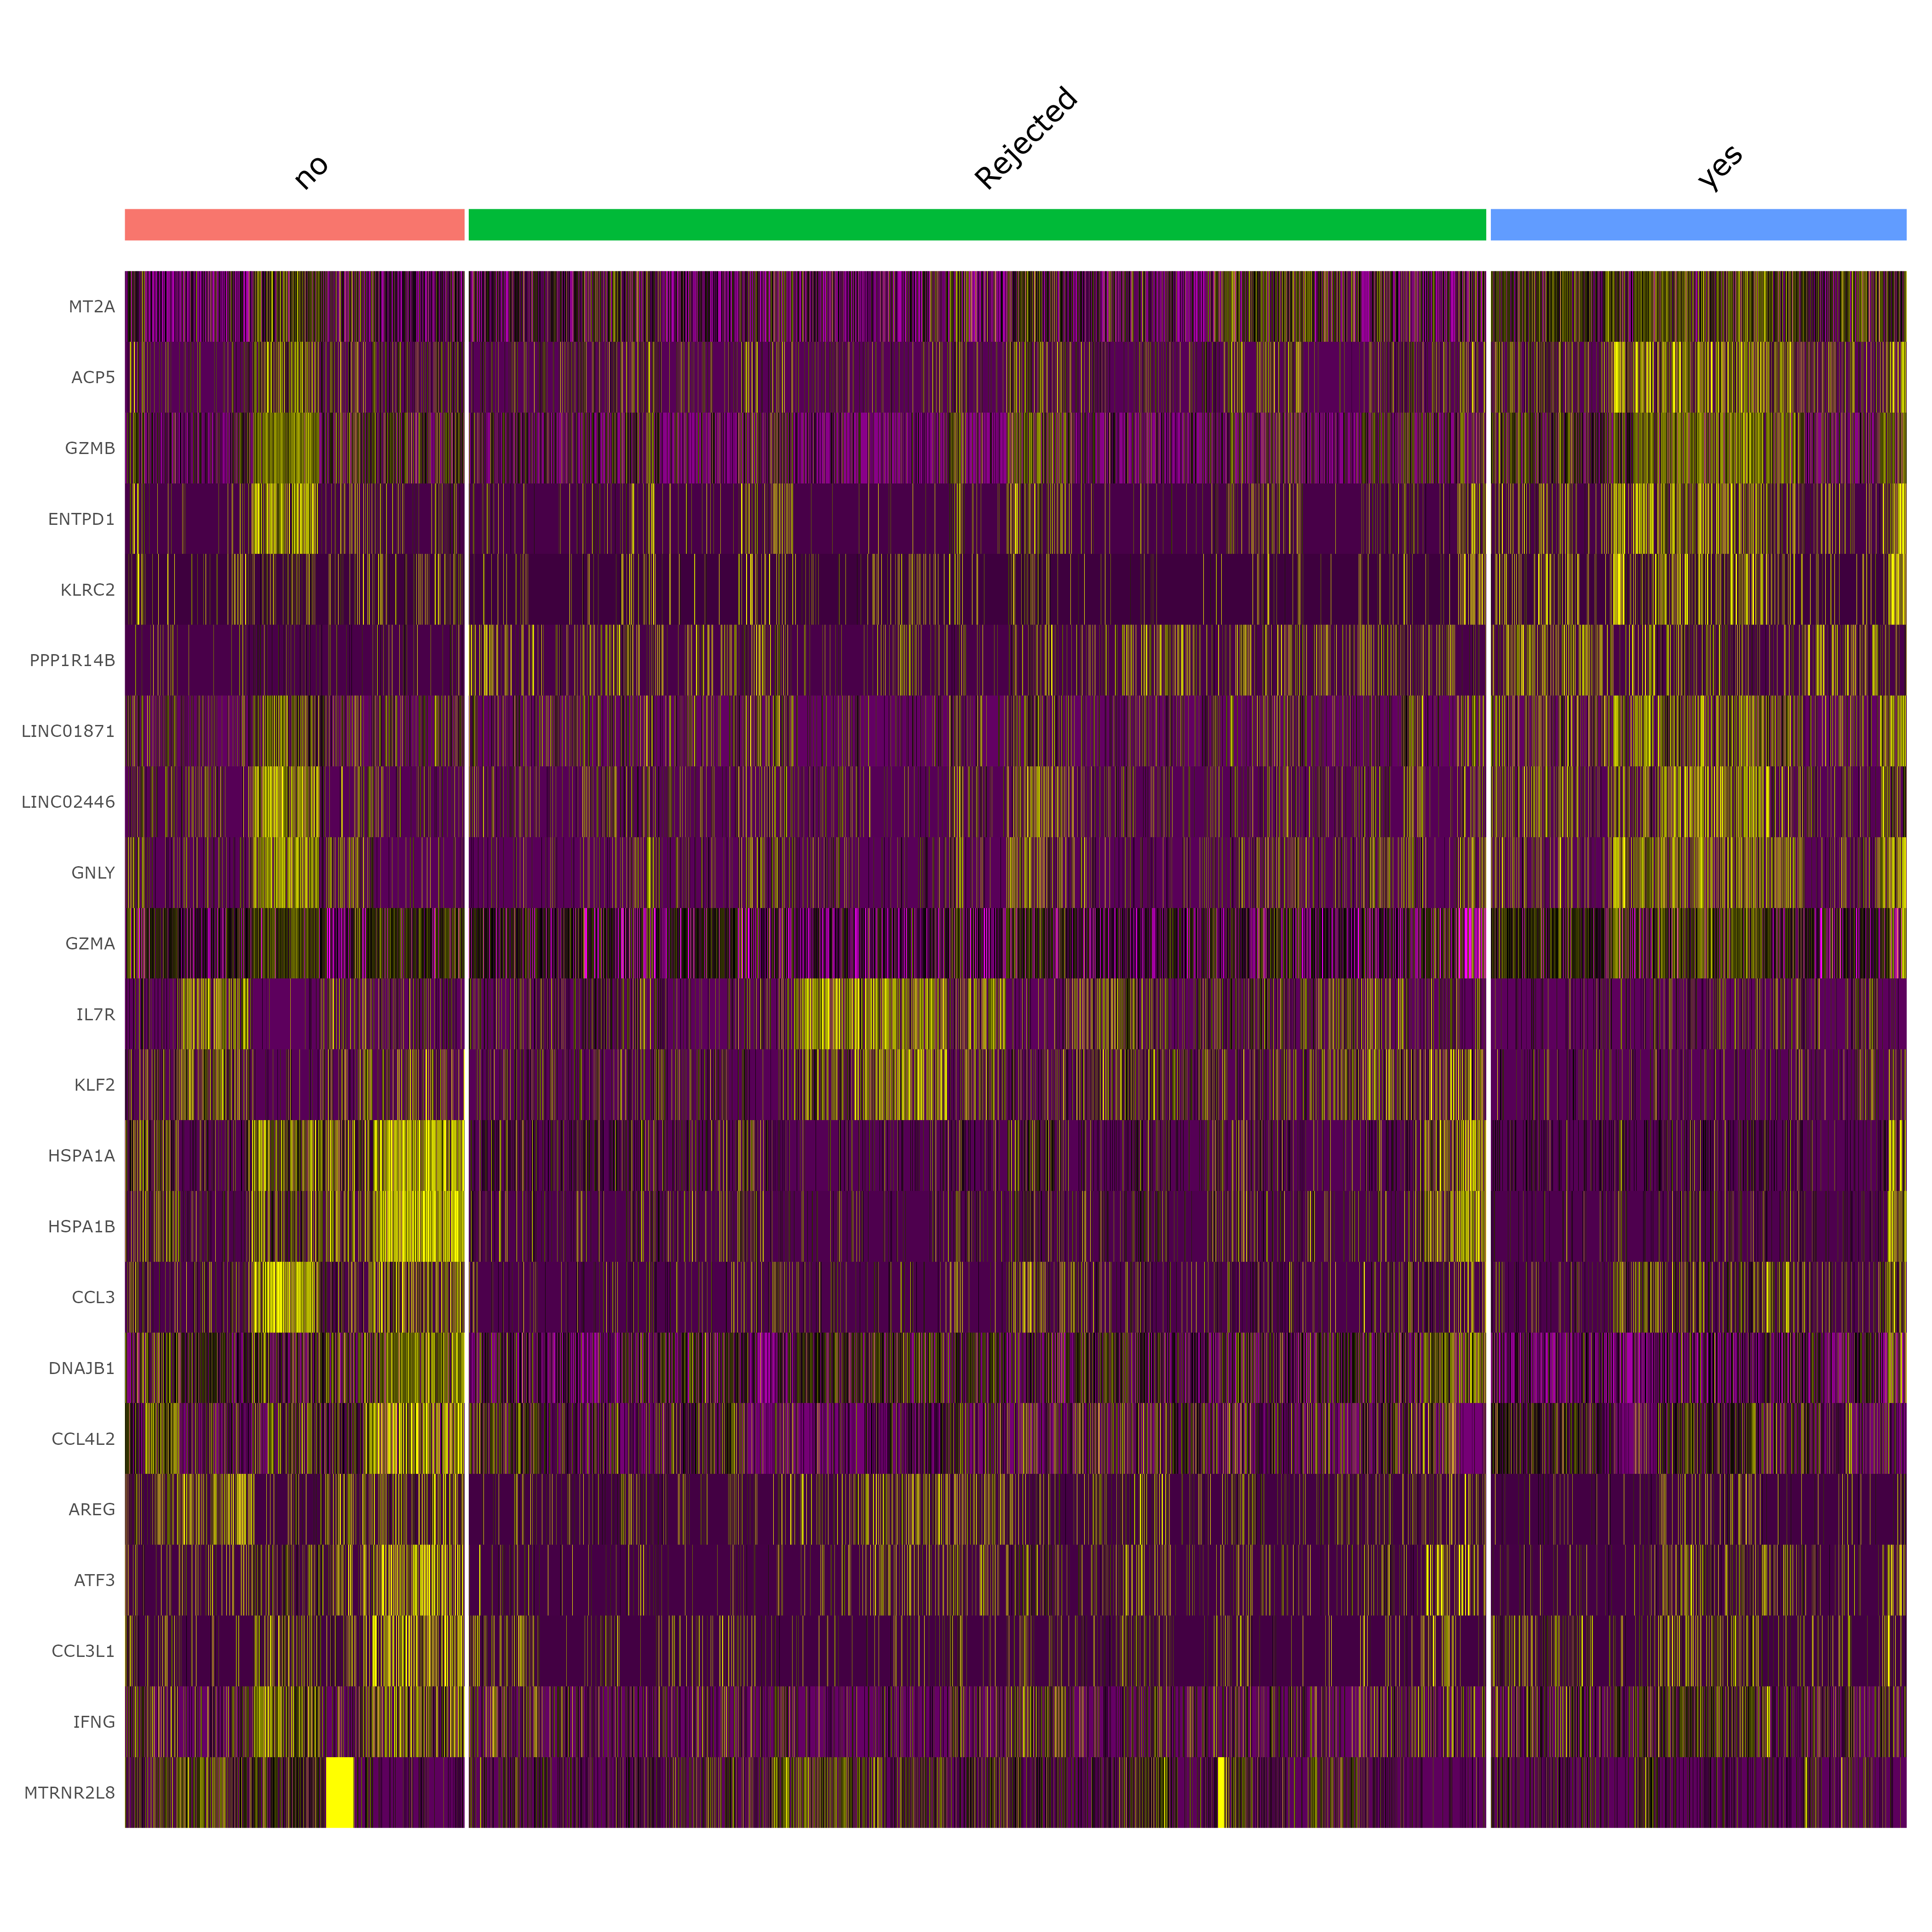
GSE200996: Marker genes for PENCIL annotated phenotype-related cells (corrected result for tissue CD8T cells)
Responder cell markers
Rejected cell markers
Non-responder cell markers

Slide 24
GSE200996: Marker gene UCell score for PENCIL annotated phenotype-related cells (corrected result for tissue CD8T cells)

Slide 25
GSE200996: Marker gene UCell score vs. ICB response (corrected result for tissue CD8T cells)
Non-responders
Responders

Slide 27
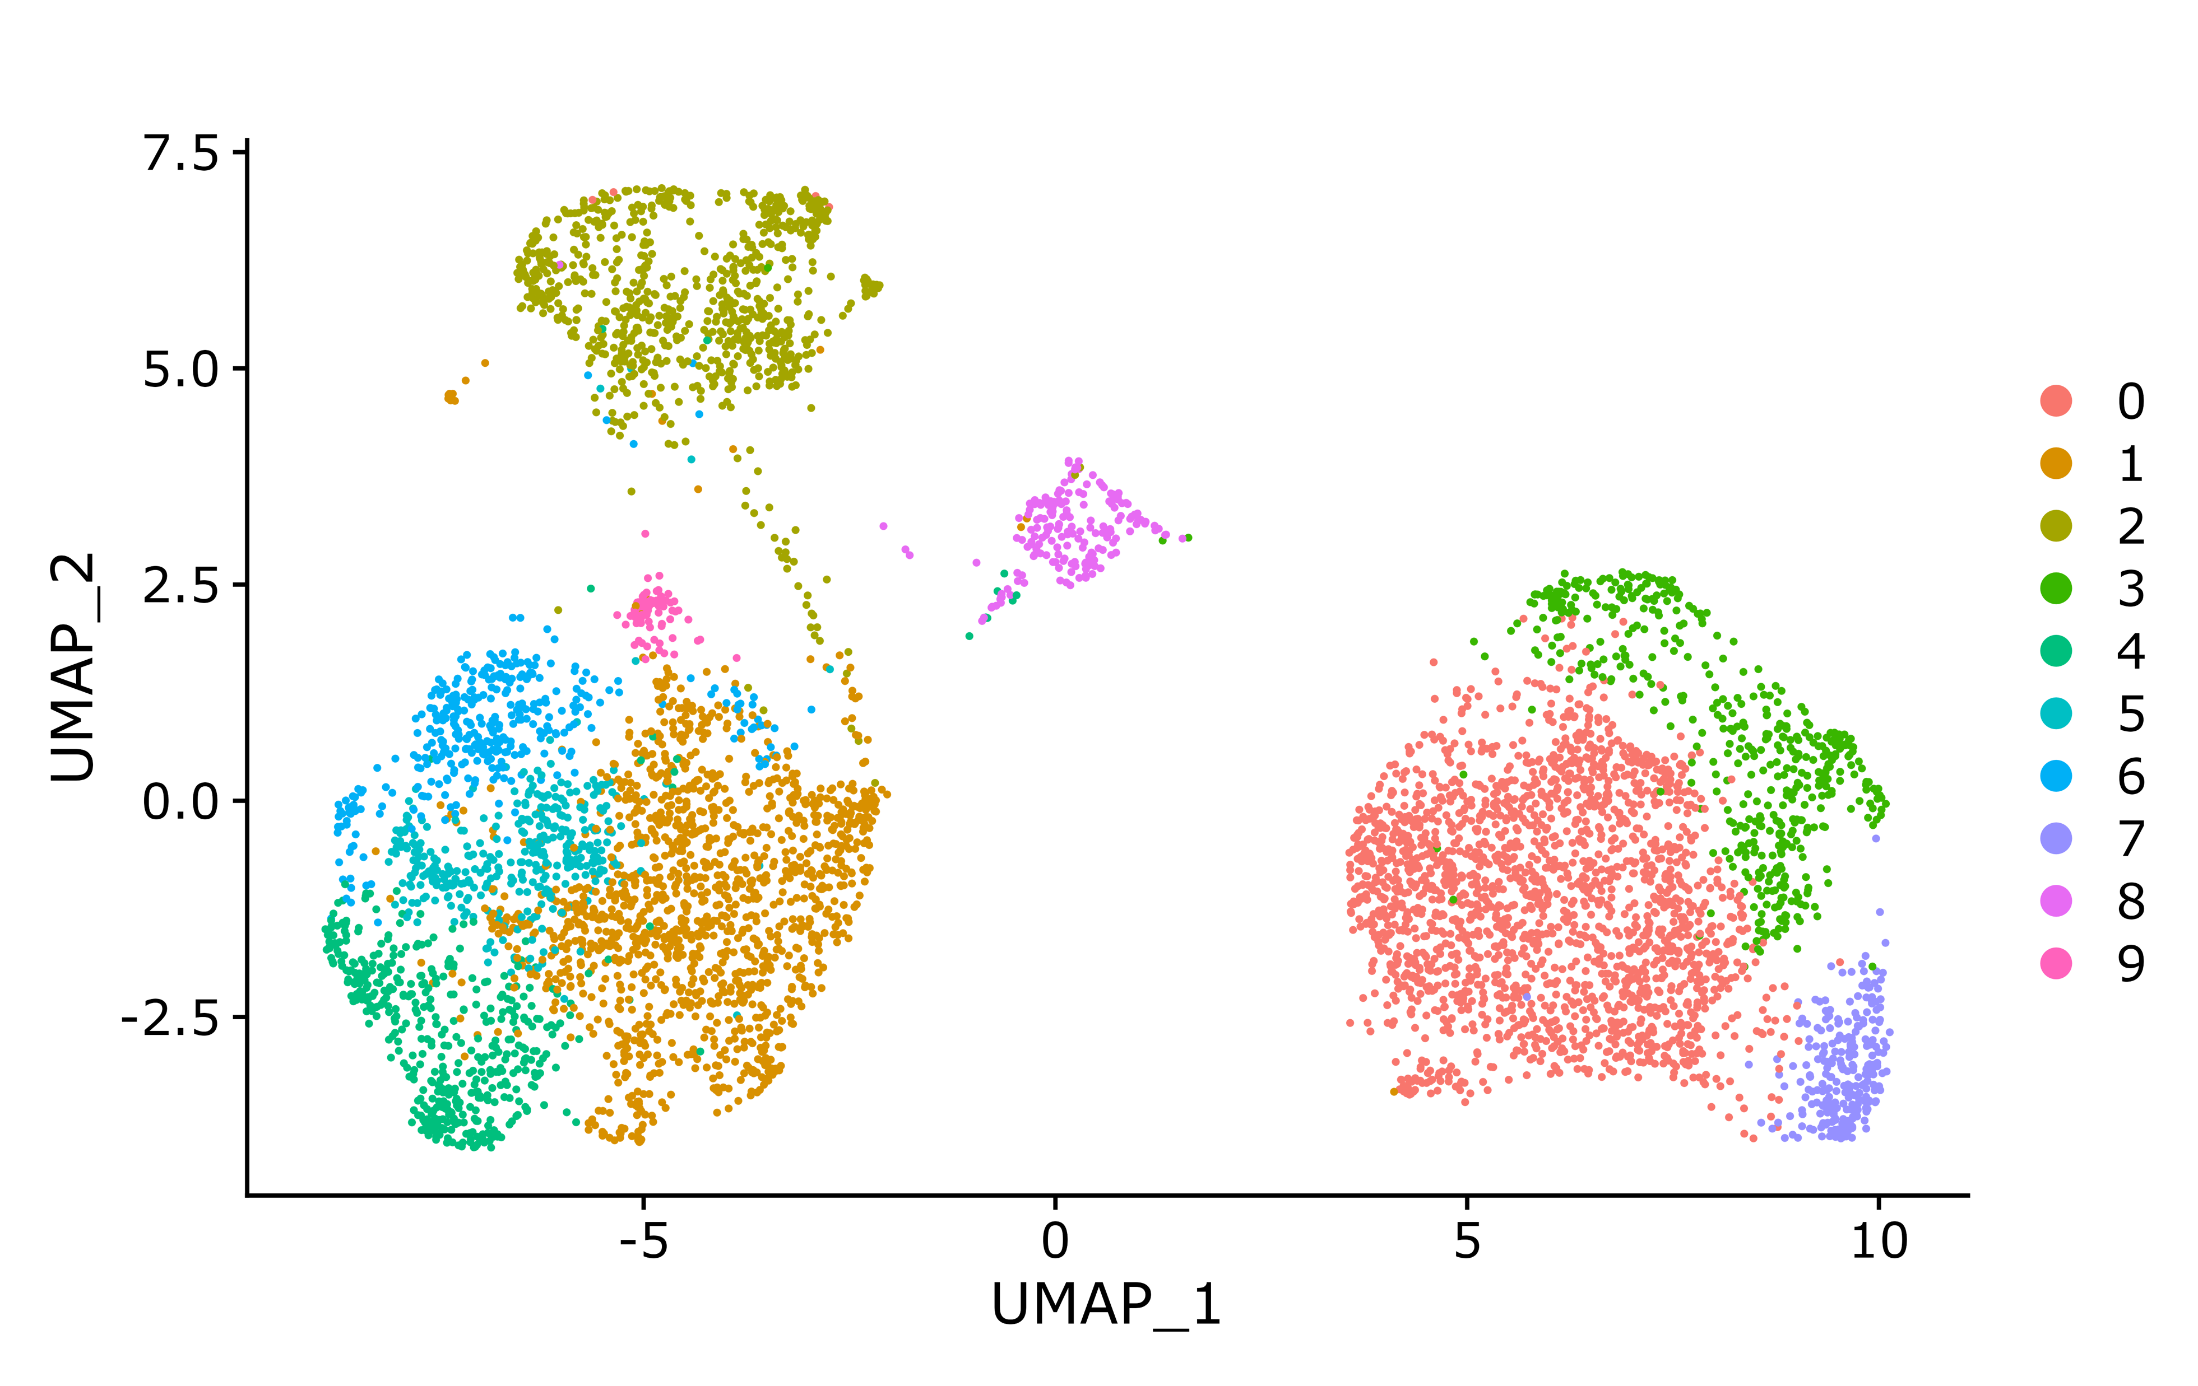
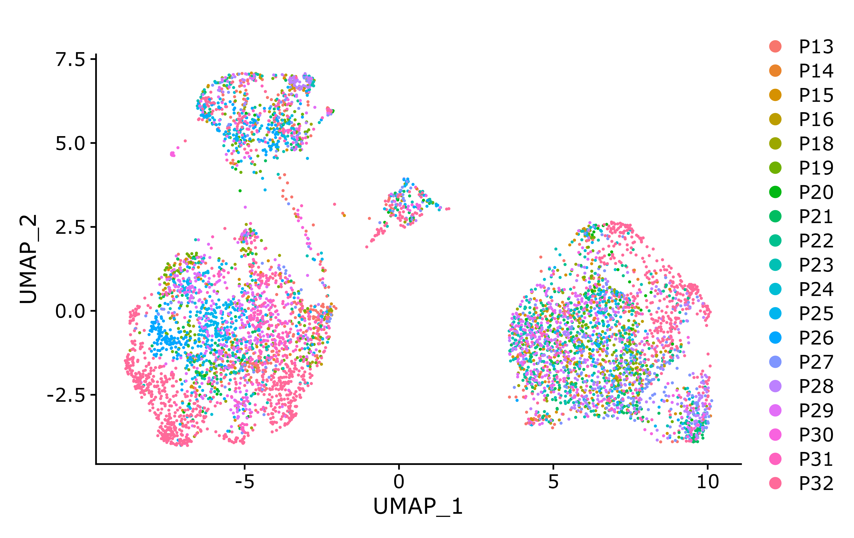
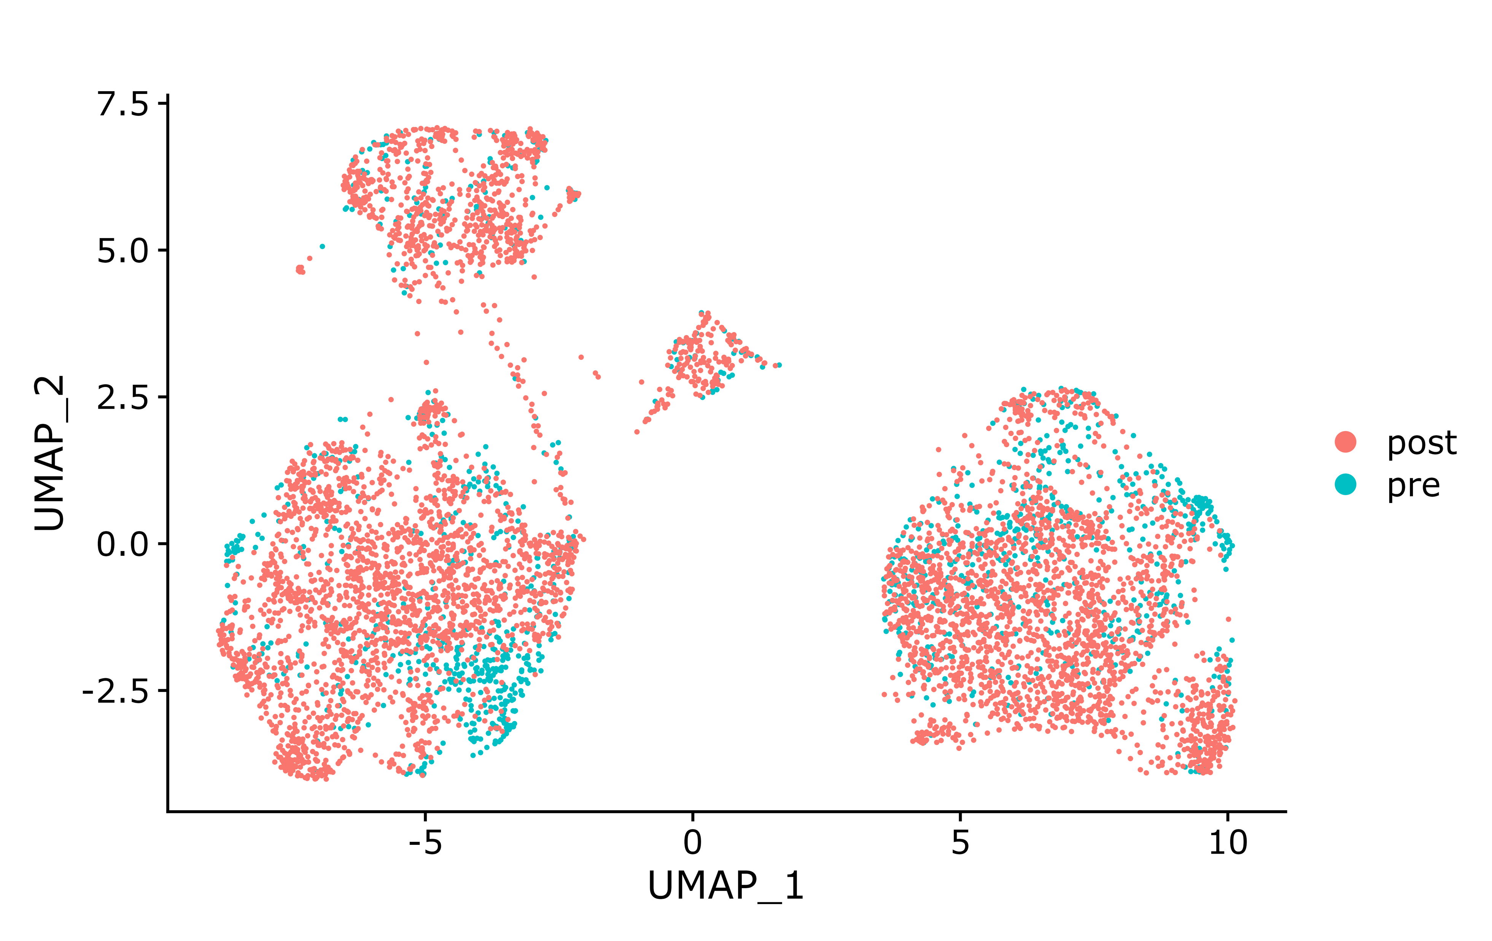
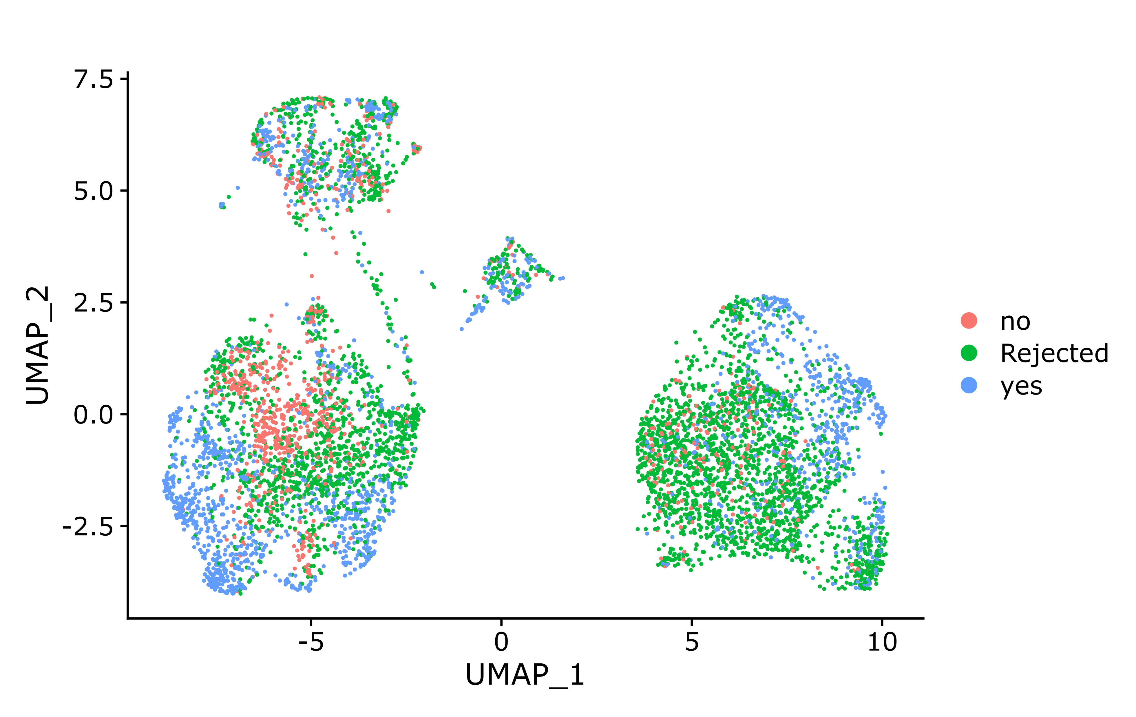
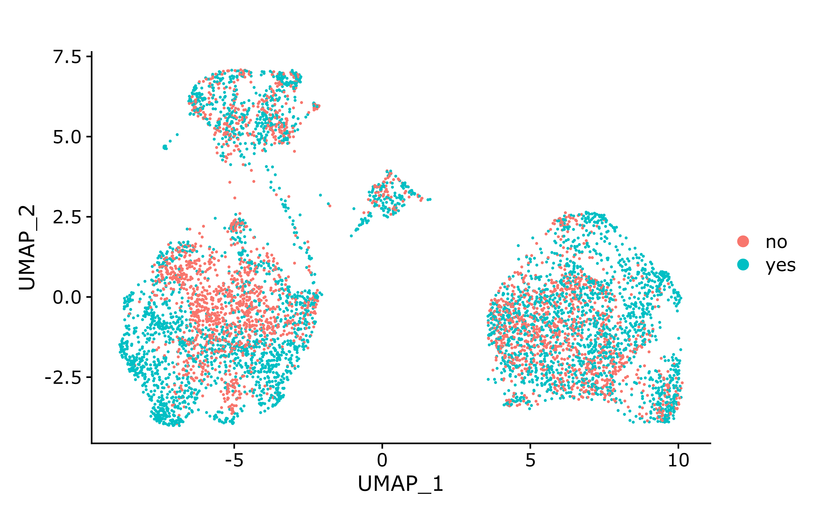
GSE200996: PENCIL result (corrected result for tissue B cells)
Seurat clusters (for reference)
Patients (check batch effect)
Time point (Pre/Post ICB)
PENCIL predicted cell labels
R/NR patients (check R/NR specific clusters)

Slide 29
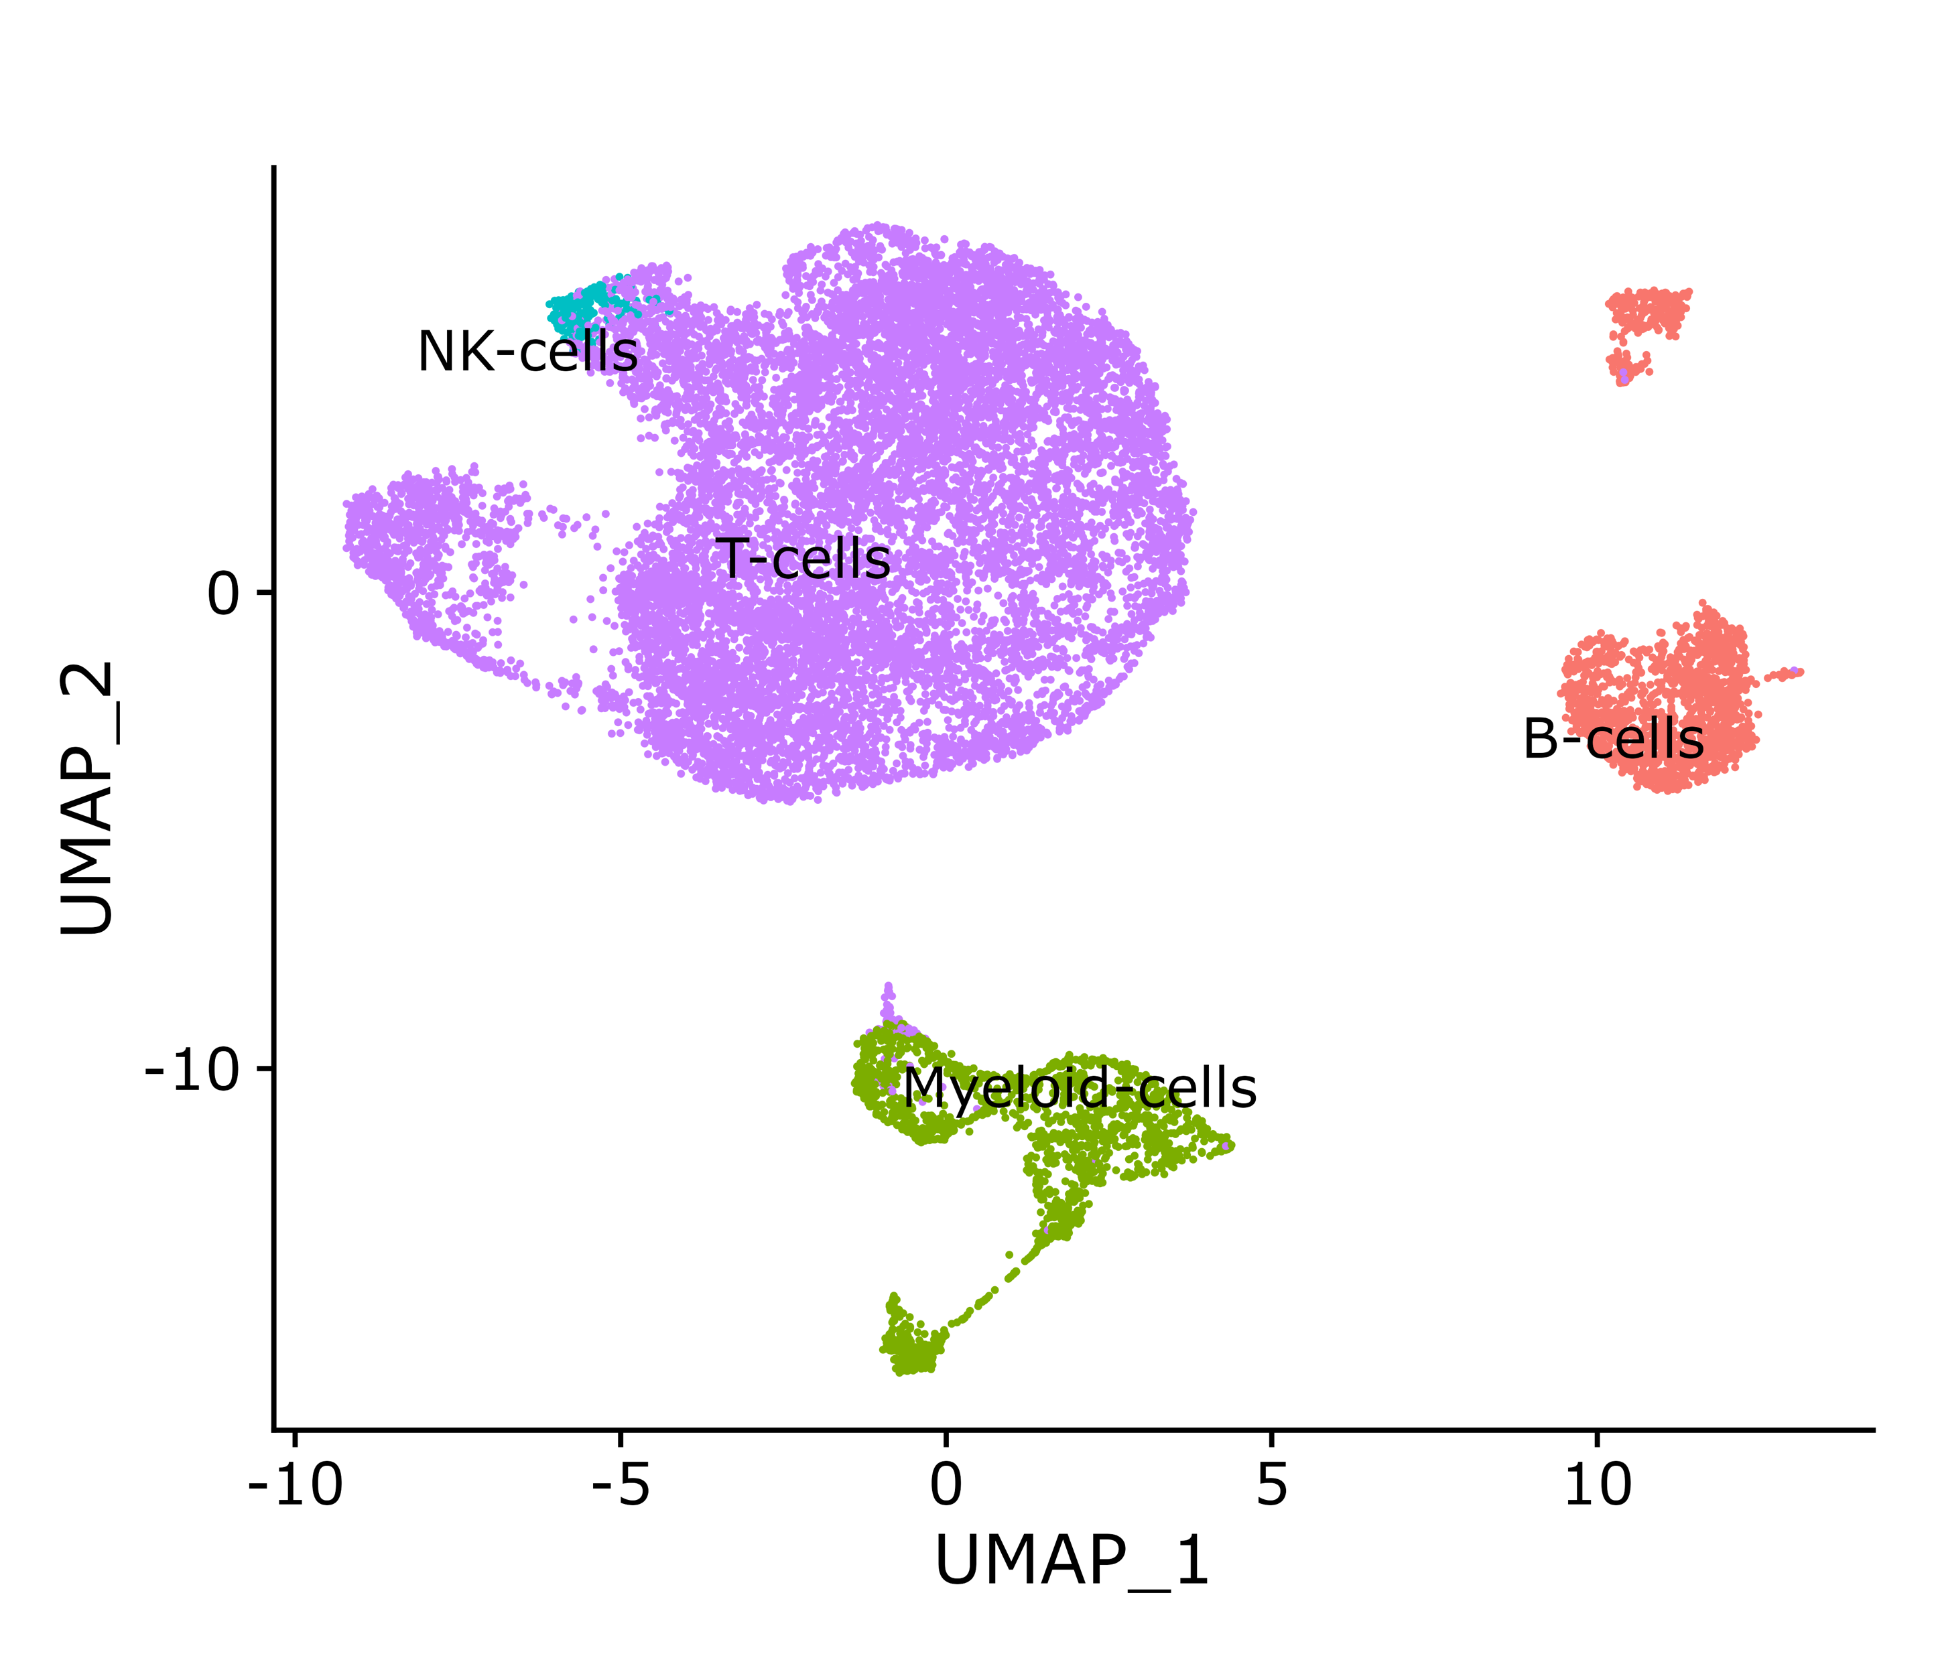
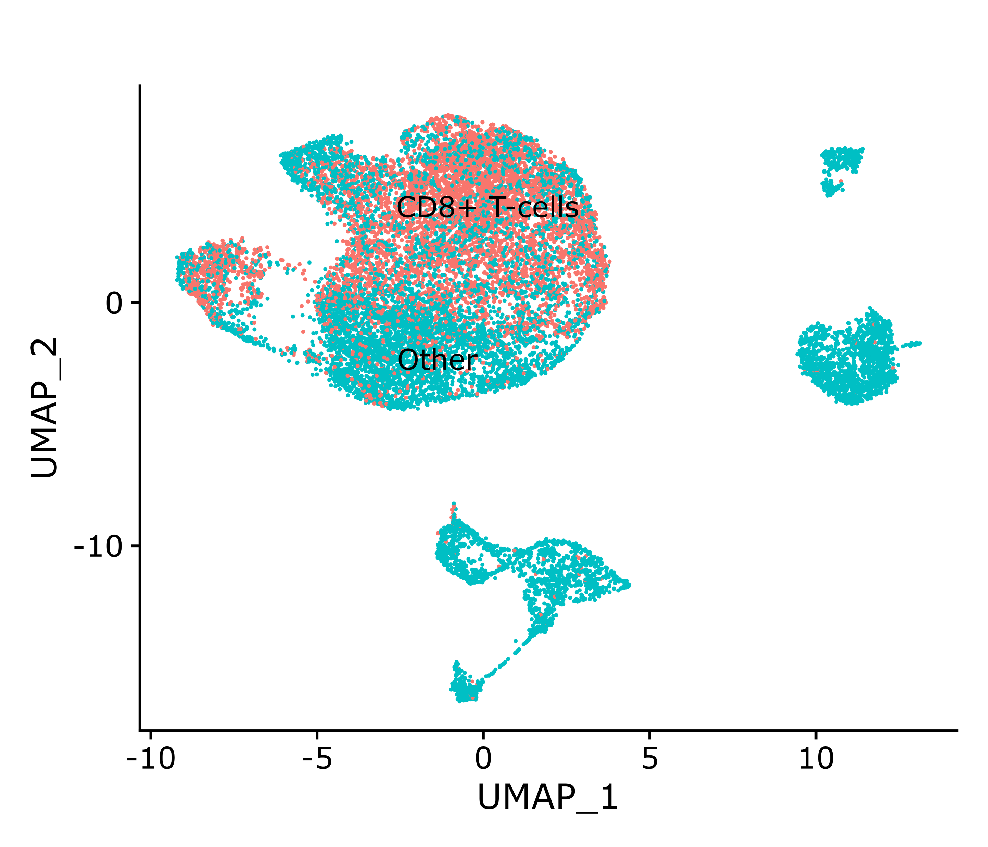

GSE120575: cell type UMAP
All cell type (16291 cells)
Custom CD8T (6319 cells)
Original CD8T (6350 cells)

Slide 30
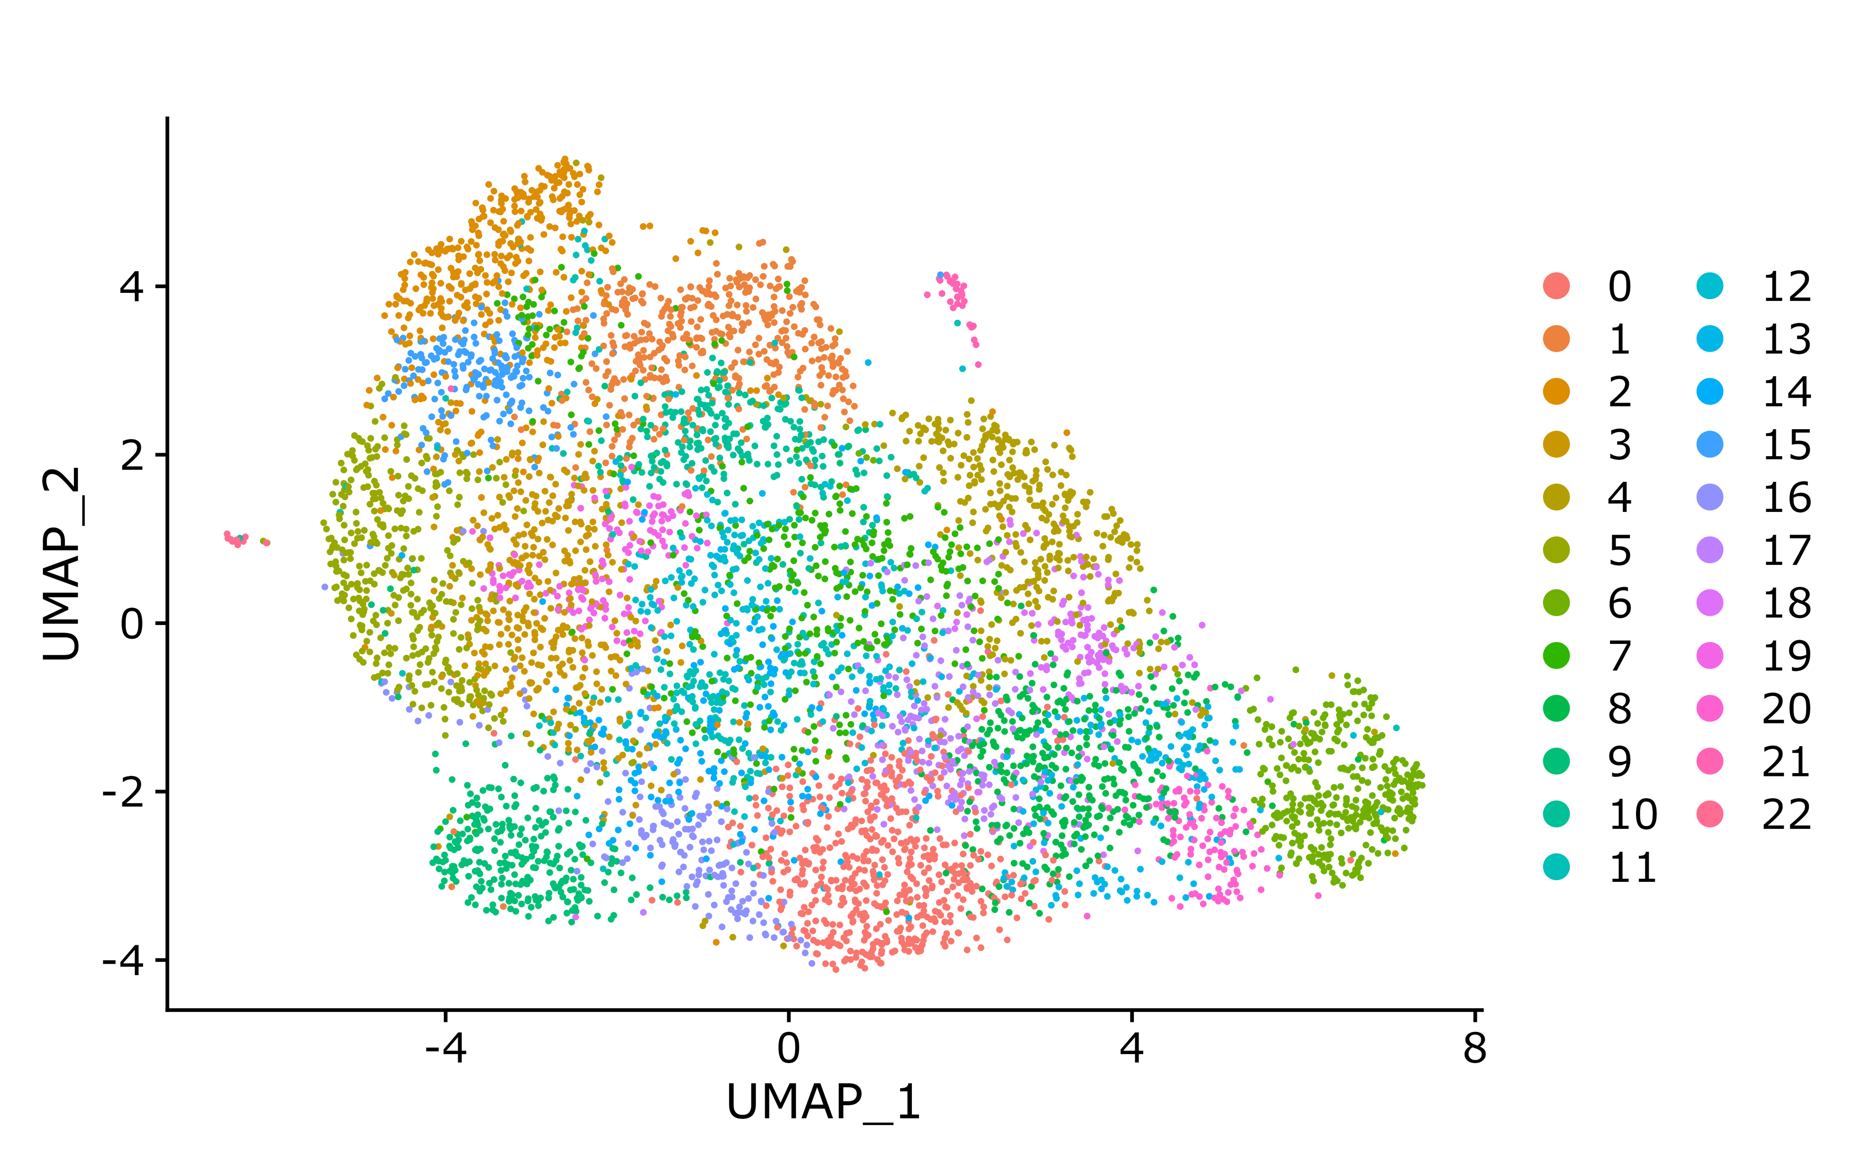
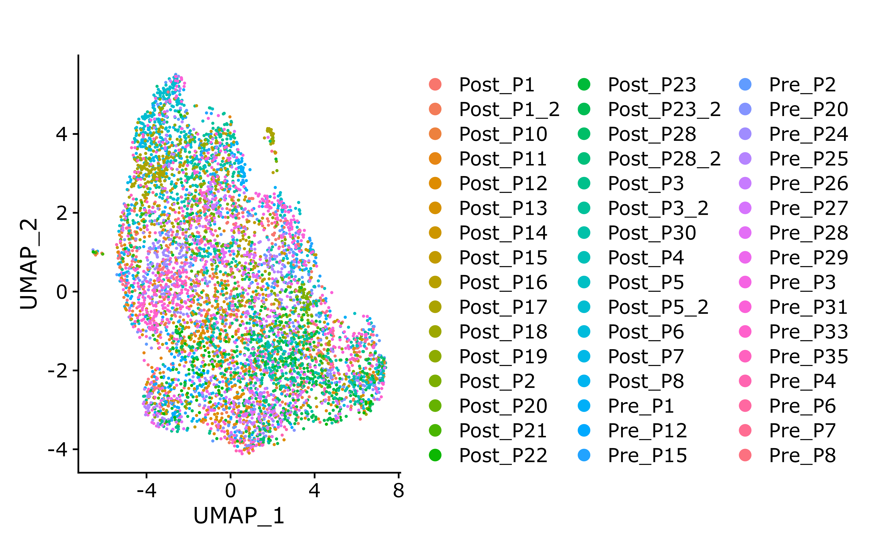
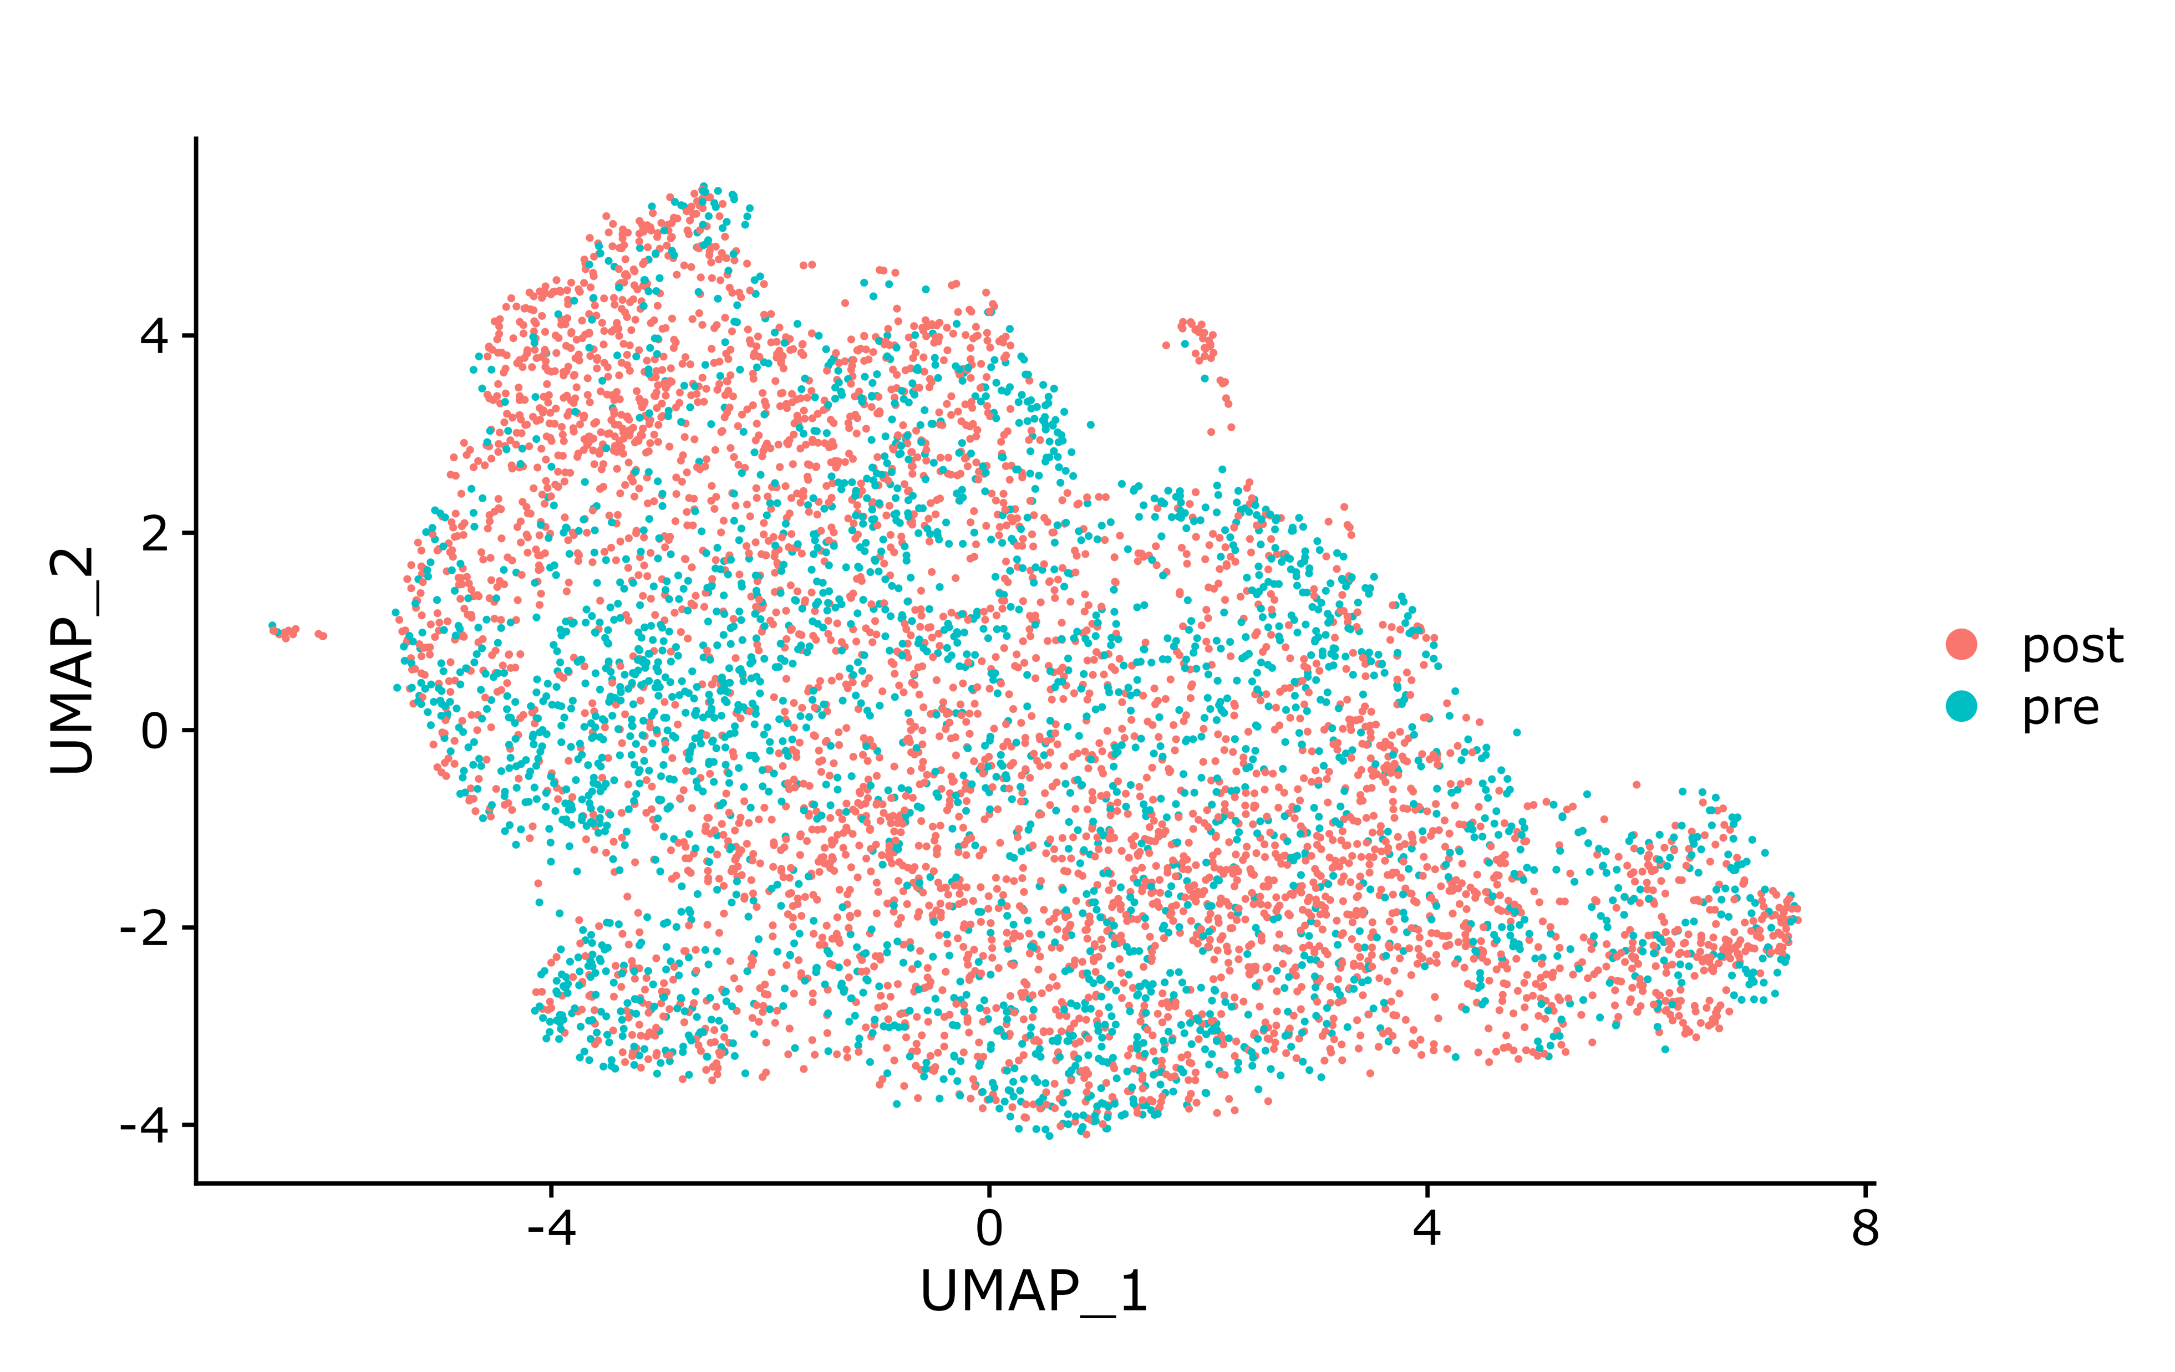
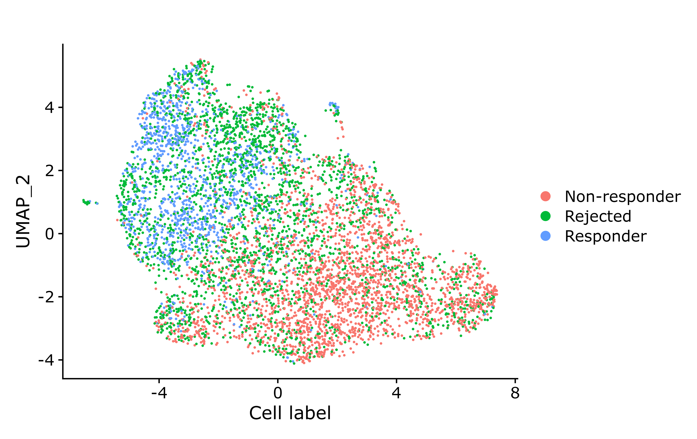

GSE120575: PENCIL result (corrected result for tissue CD8T cells)
Seurat clusters (for reference)
Patients (check batch effect)
Time point (Pre/Post ICB)
PENCIL predicted cell labels
R/NR patients (check R/NR specific clusters)

Slide 31

GSE120575: distribution of phenotype-related cells in each patient (for tissue CD8T cells, this is ALL training data)
Non-responders
Responders

Slide 32
GSE120575: distribution of phenotype-related cells in each patient (for tissue CD8T cells, 5-fold CV)
Non-responders
Responders

Slide 33
GSE120575: known ICB signature score for PENCIL annotated phenotype-related cells (corrected result for tissue CD8T cells)

Slide 36


Slide 37

Rejected cell markers
Responder cell markers
Non-responder cell markers

Slide 38
GSE120575: Marker gene UCell score for PENCIL annotated phenotype-related cells (corrected result for tissue CD8T cells)

Slide 39
GSE120575: Marker gene UCell score for R/NR patients (corrected result for tissue CD8T cells)
Non-responders
Responders

Slide 41






GSE120575: PENCIL result (corrected result for tissue all cells)
Seurat clusters (for reference)
Patients (check batch effect)
Time point (Pre/Post ICB)
PENCIL predicted cell labels
R/NR patients (check R/NR specific clusters)
Annotated cell types (for reference)

Slide 42

GSE120575: distribution of phenotype-related cells in each patient (for tissue all cells, this is ALL training data)
Non-responders
Responders

Slide 43
GSE120575: distribution of phenotype-related cells in each patient (for tissue all cells, 5-fold CV)
Non-responders
Responders

Slide 44
GSE120575: known ICB signature score for PENCIL annotated phenotype-related cells (corrected result for tissue all cells)

Slide 47


Slide 48

Responder cell markers
Rejected cell markers
Non-responder cell markers

Slide 49
GSE120575: Marker gene UCell score for PENCIL annotated phenotype-related cells (corrected result for tissue all cells)

Slide 50
GSE120575: Marker gene UCell score for R/NR patients (corrected result for tissue all cells)
Non-responders
Responders

Slide 56




Comparison with relevant tools to find phenotype associated cells
https://github.com/neurorestore/Augur
https://github.com/MarioniLab/miloR

Slide 57




Comparison with relevant tools to find phenotype associated cells
https://github.com/theislab/scCODA
https://github.com/KrishnaswamyLab/MELD

Slide 58


Comparison with relevant tools to find phenotype associated cells
https://github.com/KlugerLab/DAseq

Slide 59

Other methods to find phenotype associated cells
Paper from the same group

